Slide 1
Influenza anb covid 19 Complications

Slide 2
Influenza Complications
Children and Adolescents at Higher Risk for Influenza Complications
Children younger than 4 years
Children with chronic pulmonary (including asthma), cardiovascular (except
hypertension), renal, hepatic, hematologic, or metabolic (including diabetes mellitus) disorders
Children who are immunosuppressed, including children infected with human
immunodeficiency virus and those taking immunosuppressive medications
Children with cognitive dysfunction, spinal cord injuries, seizure disorders, or other
neuromuscular disorders)
Children who are receiving long-term aspirin therapy and who therefore might
be at risk for developing Reye syndrome

Slide 3
Adults at Higher Risk for Influenza-Related Complications
Persons aged 65 years or older
Women who will be pregnant during the influenza season
Persons with chronic pulmonary (including asthma), cardiovascular, renal,
hepatic, hematologic, or metabolic disorders (including diabetes mellitus)
Persons who have immunosuppression (including immunosuppression due to medication or human immunodeficiency virus infection)
Persons with any condition that can compromise respiratory function or the handling of respiratory secretions or increase the risk of aspiration.
Persons with obesity, defined as a body mass index greater than 40
Residents of nursing homes and other chronic-care facilities

Slide 4
Complications of Influenza
Pulmonary Complications
Nonpulmonary Complications
Myositis
Cardiac Complications
Toxic Shock Syndrome
Central Nervous Complications
Reye Syndrome

Slide 5
Pulmonary Complications
Two manifestations of pneumonia associated with influenza are well recognized:
primary influenza viral pneumonia and secondary bacterial infection.
In addition, less distinct and milder pulmonic syndromes
often occur during an outbreak of influenza that may represent tracheobronchitis, localized viral pneumonia, or possibly mixed viral and bacterial pneumonia.

Slide 6
Primary Influenza Viral Pneumonia
primary influenza viral pneumonia has occurred predominantly among persons with cardiovascular disease, especially rheumatic heart disease with mitral stenosis, and to a lesser extent in others with chronic cardiovascular and pulmonary disorders.
The illness begins with a typical onset of
influenza, followed by a rapid progression of fever, cough, dyspnea, and cyanosis.

Slide 7
Primary Influenza Viral Pneumonia
Physical examination and chest radiographs reveal bilateral findings consistent with the acute respiratory distress syndrome but no consolidation.
Blood gas studies show marked hypoxia,
Gram stain of the sputum fails to reveal significant bacteria,
and bacterial culture yields sparse growth of normal flora, whereas viral cultures yield high titers of influenza A virus.
Such patients do not respond to antibiotics,
and mortality is high.

Slide 8
Secondary Bacterial Pneumonia
The patient has a classic influenza illness followed by a period of improvement lasting usually 4 to 14 days.
Recrudescence of fever is associated with symptoms and signs of bacterial pneumonia such as cough, sputum production, and an area of consolidation detected at physical examination and on a chest radiograph.
The two pathogens that are currently most commonly associated with influenza are Streptococcus pneumoniae and Staphylococcus aureus, which is otherwise an uncommon cause of community-acquired pneumonia.
Notes:
These include Aspergillus
sp., Chlamydia pneumoniae, B-hemolytic streptococci, and
Legionella pneumophila.35

Slide 9
In addition, milder forms of influenza viral pneumonia involving only one lobe or segment have been described, and that are more likely to be confused with pneumonia caused by Mycoplasma pneumoniae.
Some studies have suggested that elevated levels of procalcitonin or C-reactive protein can be helpful in distinguishing secondary bacterial from primary viral Pneumonia.

Slide 10
Pulmonary Complications in
Immunosuppressed Patients
Severe disease associated with pneumonia and death has been reported, particularly in bone marrow transplant recipients and leukemic patients.
Influenza virus shedding can be quite prolonged in immunosuppressed children, particularly those with human immunodeficiency virus (HIV) and low CD4+ counts.

Slide 11
Other Pulmonary Complications
Bronchiolitis may also occur as a result of influenza A or B virus infection.
Acute exacerbation of chronic bronchitis is a common complication of influenza and may result in a permanent loss of pulmonary function.
Exacerbations of asthma and worsening pulmonary function in children with cystic fibrosis may also occur.

Slide 12
Nonpulmonary Complications
Myositis
Cardiac Complications
Toxic Shock Syndrome
Central Nervous Complications
Reye Syndrome

Slide 13
Myositis
Myositis and myoglobinuria with tender leg muscles and elevated serum creatine phosphokinase (CPK) levels have been reported, mostly in children, but they can also occur in adults.
Symptoms may be sufficiently severe to interfere with walking.

Slide 14
Cardiac Complications
Both myocarditis and pericarditis have been rarely associated with influenza A or B virus infection.
Myocardial infarction may also be triggered by influenza infection, possibly as an effect of platelet aggregation.
Studies have shown a substantially increased risk of myocardial infarction in the 7 days after hospitalization for influenza.

Slide 15
Toxic Shock Syndrome
In recent outbreaks of influenza A or B, a toxic shock–like syndrome has occurred in previously healthy children or adults.

Slide 16
Central Nervous Complications
Guillain-Barre syndrome (GBS) has been reported to occur after influenza A infection, but no definite etiologic relationship has been established.
In addition, cases of transverse myelitis and encephalitis and encephalopathy have occurred rarely.
Most cases occur in children, but associated morbidity is higher in adults.
The specific pathogenesis of influenza-associated encephalitis is unclear but may be related to the cytokine response

Slide 17
Reye Syndrome
Reye syndrome is associated with many viral infections, prominently including influenza and varicella in children.
The classic manifestation is a change in mental status occurring several days after a typical respiratory illness.
Manifestations range from lethargy to delirium, seizures, and respiratory arrest.
Reye syndrome is almost exclusively seen in children who have been given aspirin for treatment of febrile illnesses due to influenza and other viruses.
Children who require continuous aspirin therapy are an important target group for influenza vaccination to reduce the risks of Reye syndrome.
Notes:
The most frequent
laboratory abnormality is elevation of the blood ammonia value, which
occurs in almost all patients

Slide 18
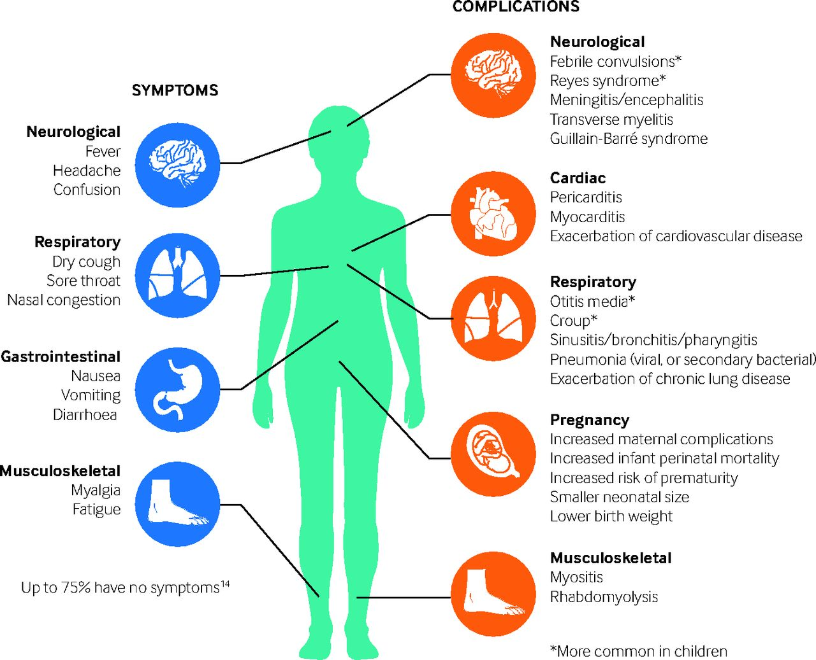

Slide 19
Complications from COVID-19
40% of COVID-19 cases develop mild symptoms (fever, cough, dyspnea, myalgia or arthralgia, odynophagia, fatigue, diarrhea, and headache),
40% have moderate symptoms (pneumonia),
15% develop severe clinical manifestations (severe pneumonia) that require oxygen therapy, and
5% develop a critical clinical picture presenting with one or more of the following complications.

Slide 20
Complications from COVID-19
respiratory failure,
acute respiratory distress syndrome (ARDS),
sepsis and septic shock,
thromboembolism and coagulation disorders,
and/or multiple organ failure including acute renal failure , liver failure , heart failure,
cardiogenic shock, myocarditis ,
or cerebrovascular accident.

Slide 21
Complications from COVID-19 occur mainly in persons with risk factors:
older adults,
smokers,
and those with underlying comorbidities such as hypertension, obesity, diabetes, cardiovascular disease, chronic lung disease (for example, chronic obstructive pulmonary disease-COPD- and asthma), chronic kidney disease, chronic liver disease, cerebrovascular disease, cancer, and immunodeficiency.

Slide 22
The main complications documented with COVID-19, in addition to those related to the respiratory system, are neurological , including delirium or encephalopathy, cerebrovascular accident, meningoencephalitis , alteration of the senses of smell (anosmia) and taste (hypogeusia) , anxiety, depression, and sleep disorders .
In many cases, neurological manifestations have been reported even in the absence of respiratory symptoms.
There are also reports of cases of Guillain-Barré Syndrome (GBS) in patients with COVID-19

Slide 23
Sequelae in the respiratory system
The main sequelae of patients who developed a severe clinical picture of COVID-19 is the development of pulmonary fibrosis.
During the next phase of infection, which usually occurs between the second and fifth week, the lungs show signs of fibrosis.
During the final stage, between the sixth and eighth week, the lung tissue becomes fibrotic. Additionally, there are several reports of bilateral lesions with a predominance of the lower lobe.

Slide 24
Sequelae in the cardiovascular system
It has been documented that patients with severe forms of COVID-19 presented with significant myocardial lesions, including infection-related myocarditis, with reduced systolic function and arrhythmias.
The morbidity and lethality of the disease could be high, especially in patients with pre-existing cardiovascular conditions.

Slide 25
Thrombosis
COVID-19 is associated with disorders of coagulation,
evidenced by elevated plasma D-dimer levels, as well as
autopsy studies showing fibrin thrombi within small
vessels and capillaries.
Venous thrombosis is common in patients with COVID-19 admitted to the ICU, with reported incidence rates as high as 15% to 28%.
In hospitalized COVID-19 patients with VTE, DVT appears to be more common than pulmonary embolism (PE).

Slide 26
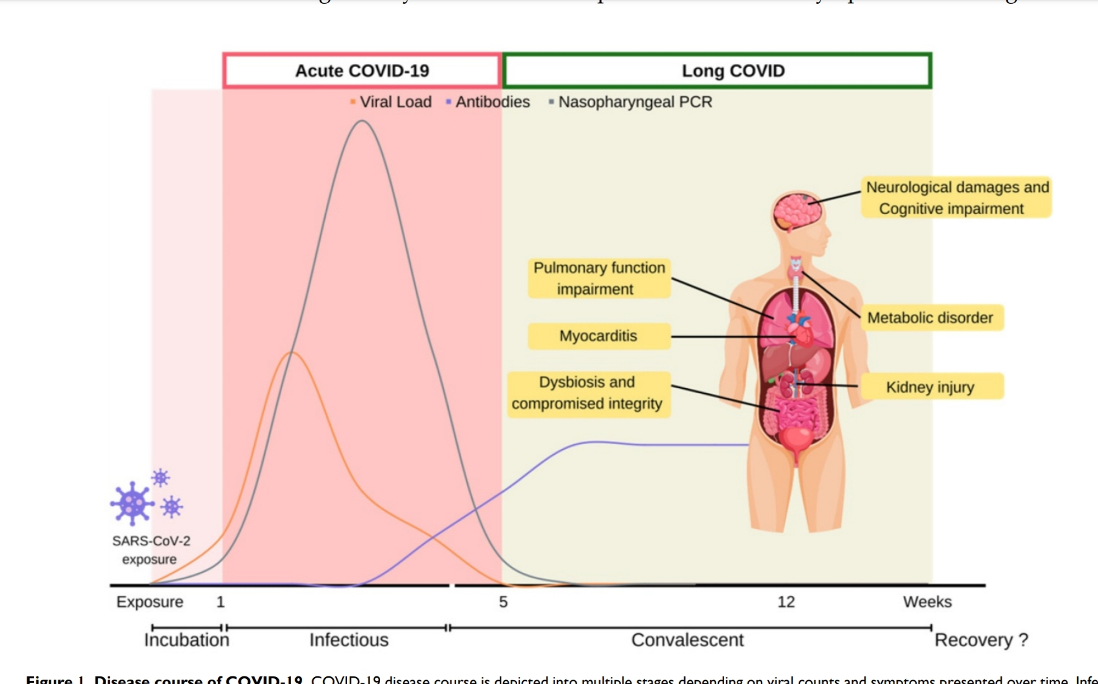

Slide 27
