Slide 1
treatment for influenza and
Covid-19

Slide 2

Treatment of influenza
Treatment recommendations for non-complicated cases include:
•Rest
•Analgesics
•Fluids
•Time

Slide 3
Antiviral treatment also can be considered for any previously healthy,symptomatic outpatient not at high risk for influenza complication,who is diagnosed with confirmed or suspected influenza,on the basis of clinical judgment,if treatment can be initiated within 48 hours of illness onset.

Slide 4
Antiviral treatment is recommended as soon as possible for any patient with suspected or confirmed influenza who:
Is hospitalized
Has severe complicated or progressive illness or
Is at higher risk for influenza complications.

Slide 5
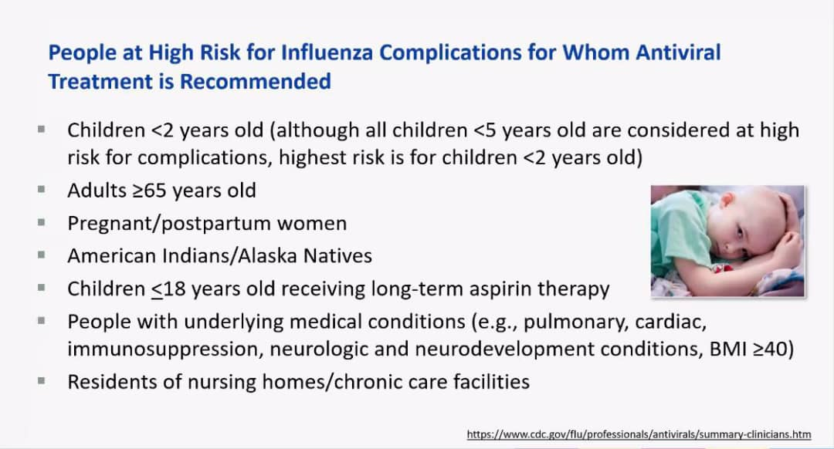

Slide 6
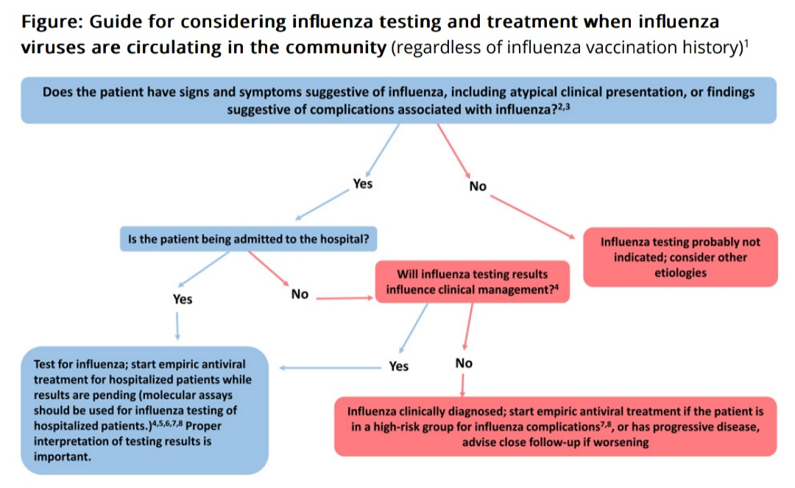

Slide 7
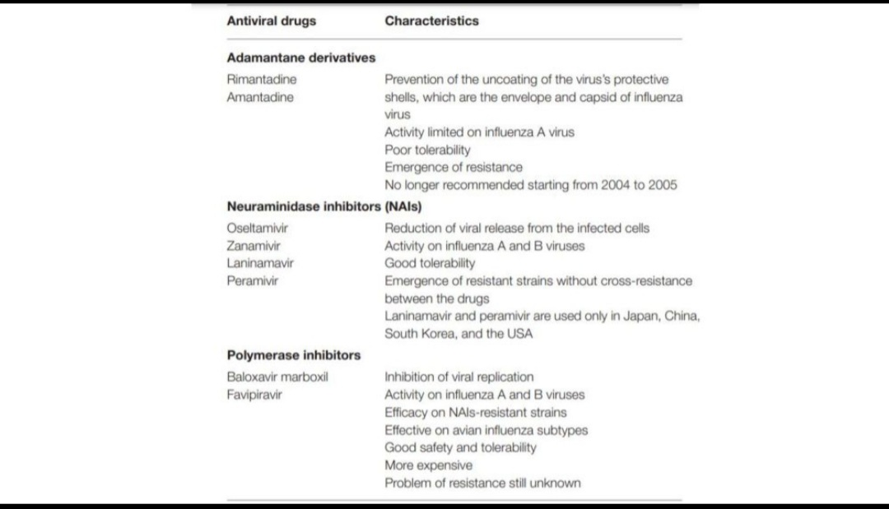

Slide 8
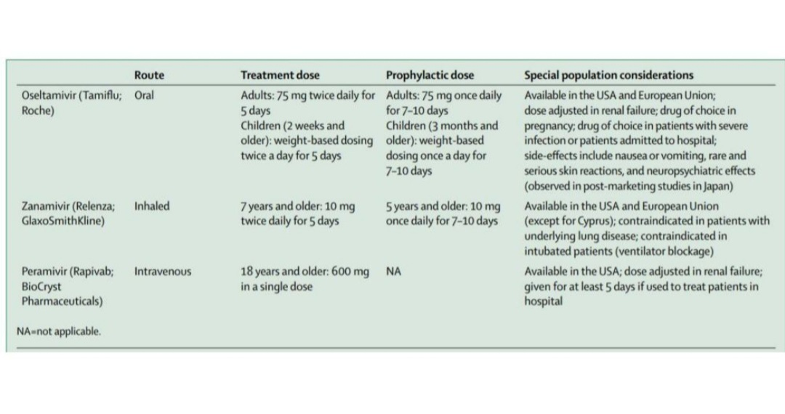

Slide 9
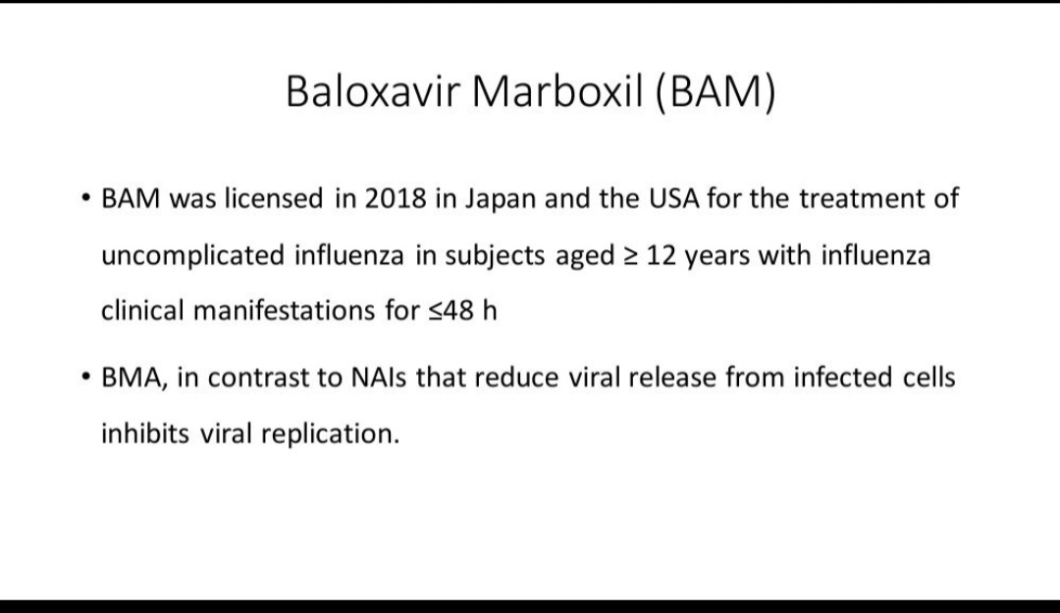

Slide 10
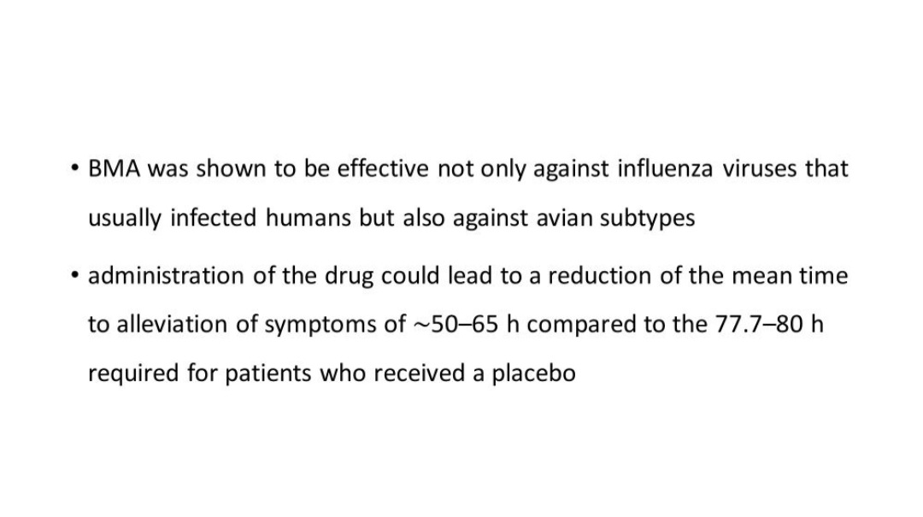

Slide 11
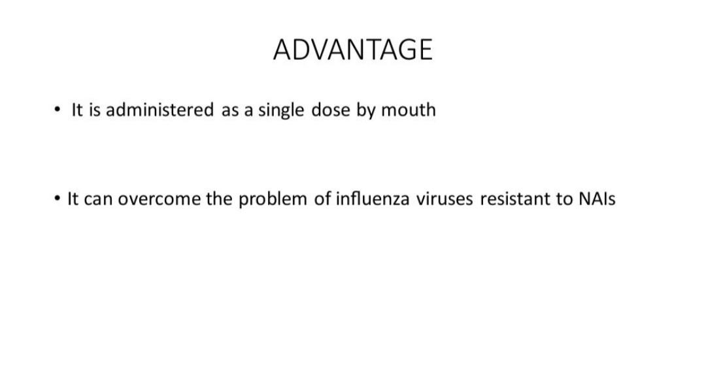

Slide 12
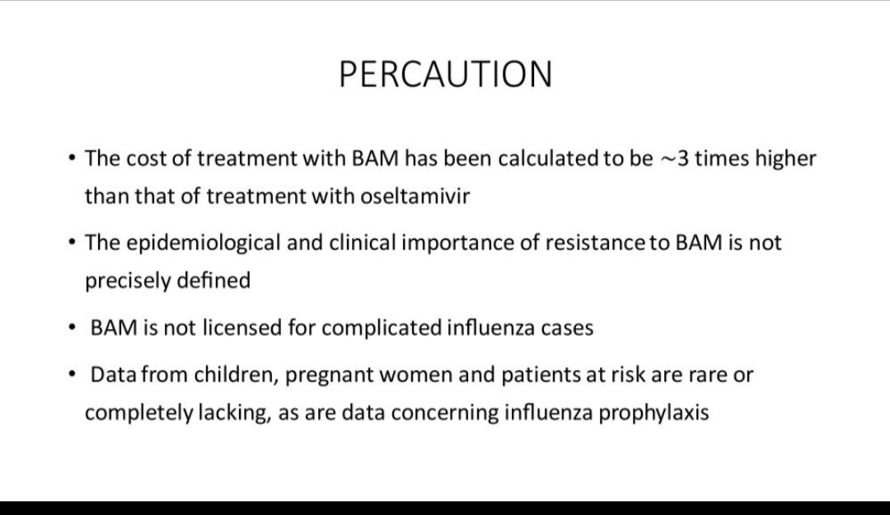

Slide 13
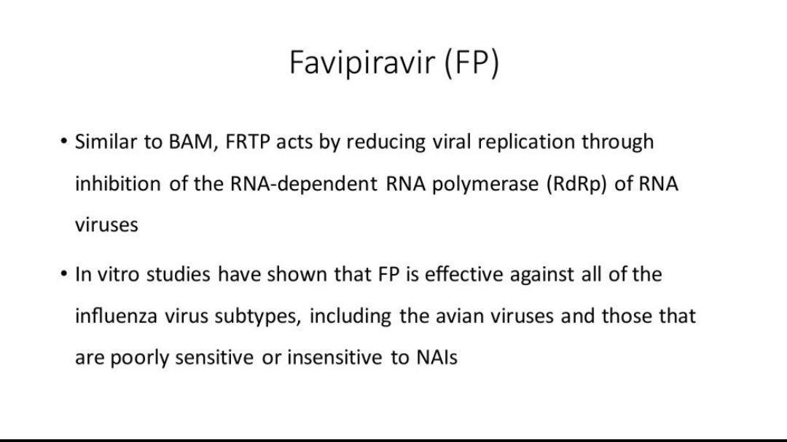

Slide 14
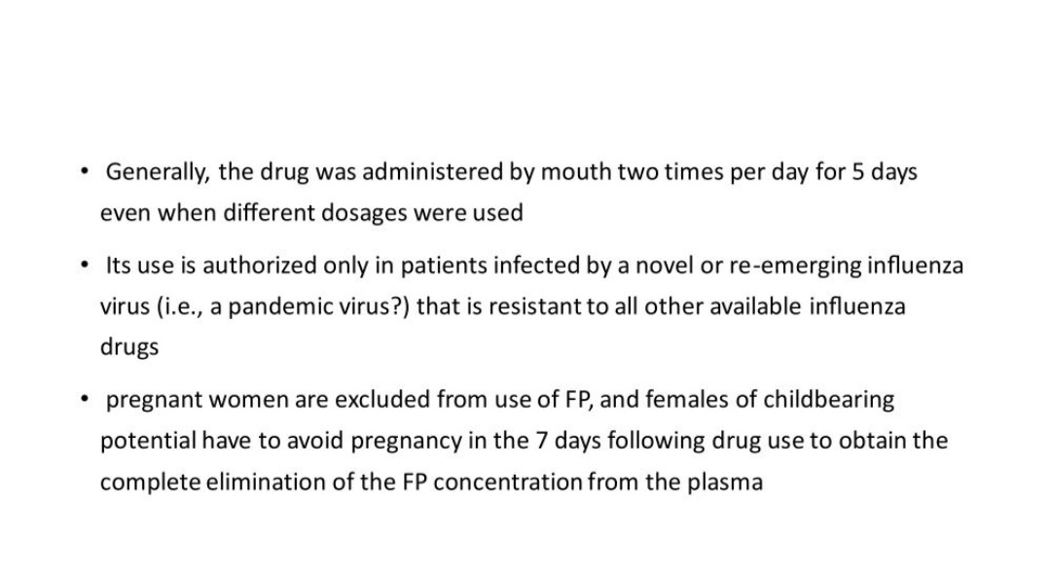

Slide 15
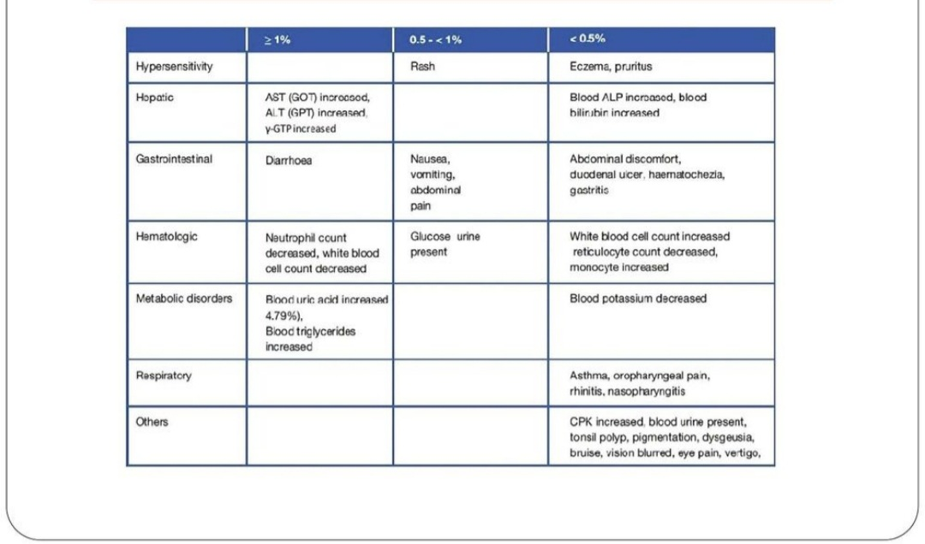

Slide 16
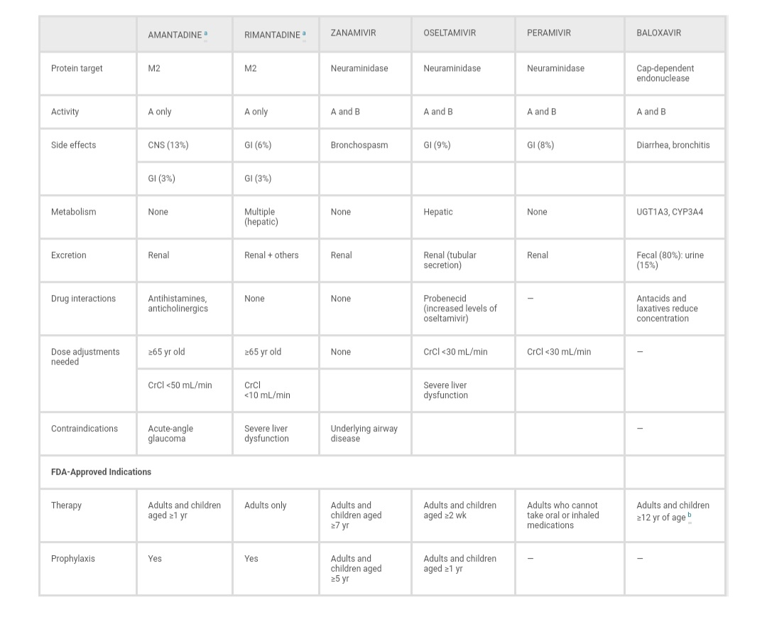

Slide 17
Treatment of covid-19

Slide 18
Antiviral

Slide 19
Nirmatrelvir-ritonavir

Slide 20
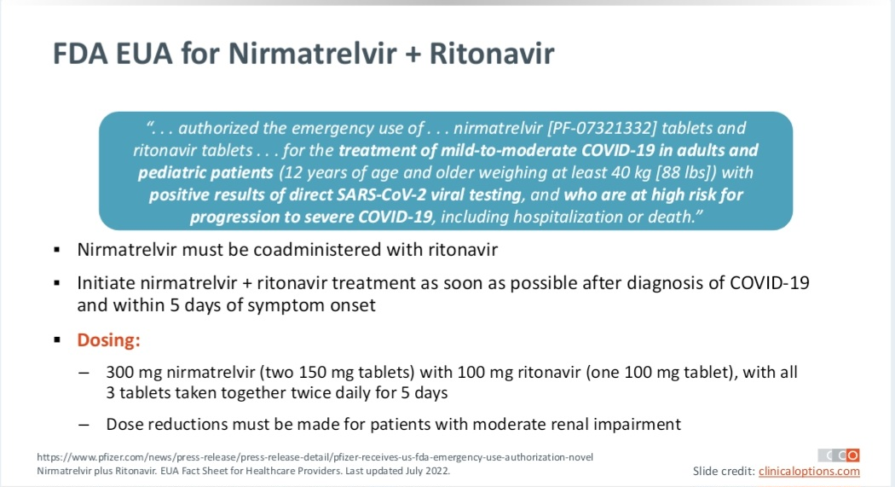

Slide 21
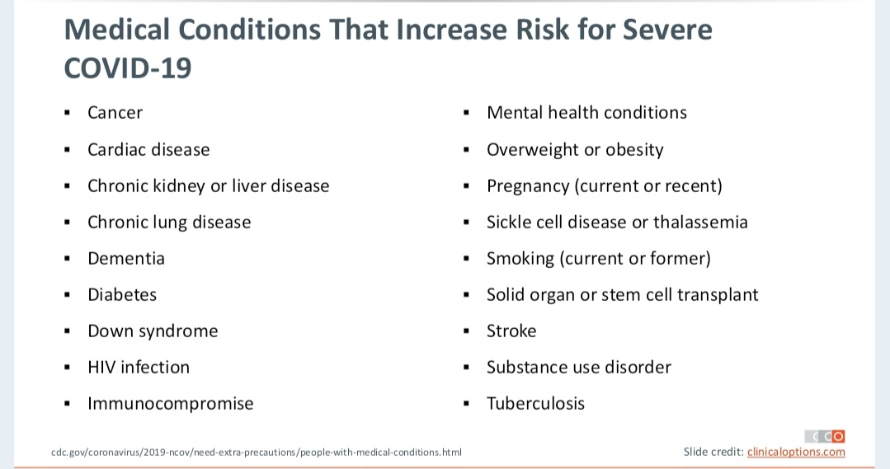

Slide 22
Remdesivir

Slide 23
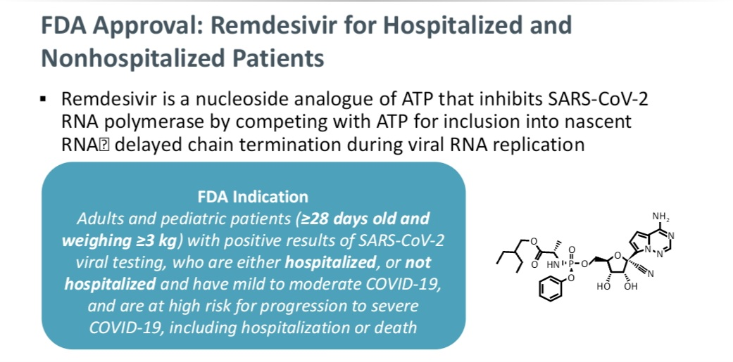

Slide 24
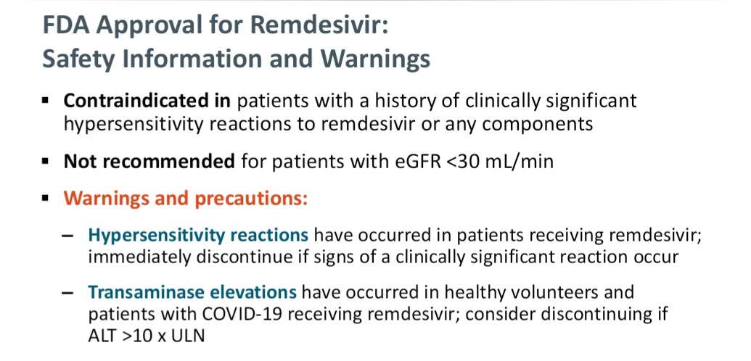

Slide 25
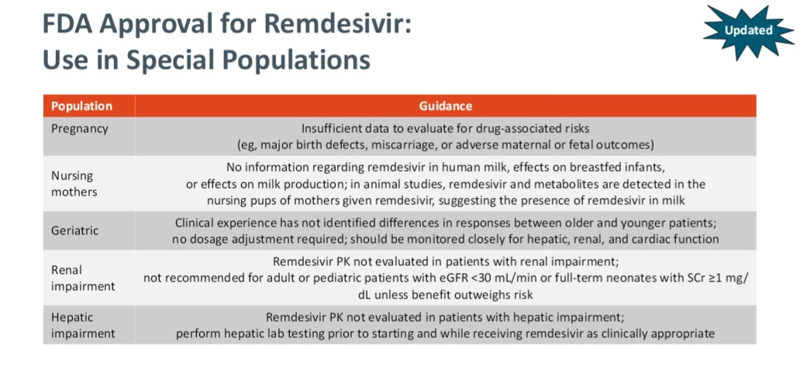

Slide 26
Molnupiravir

Slide 27
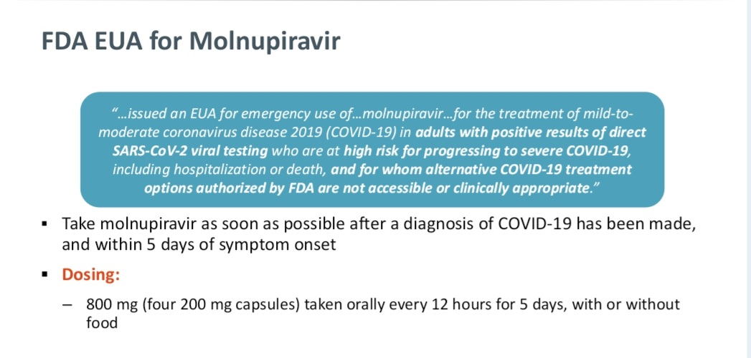

Slide 28
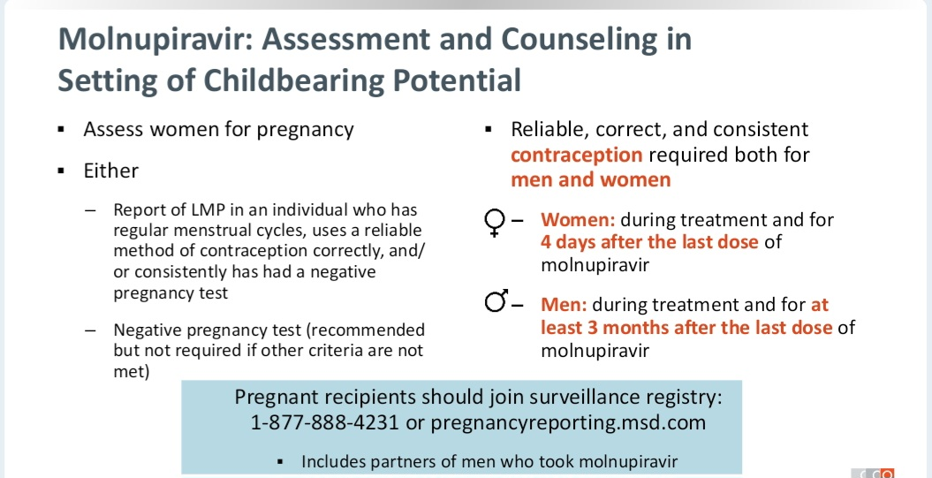

Slide 29
Corticosteroid

Slide 30
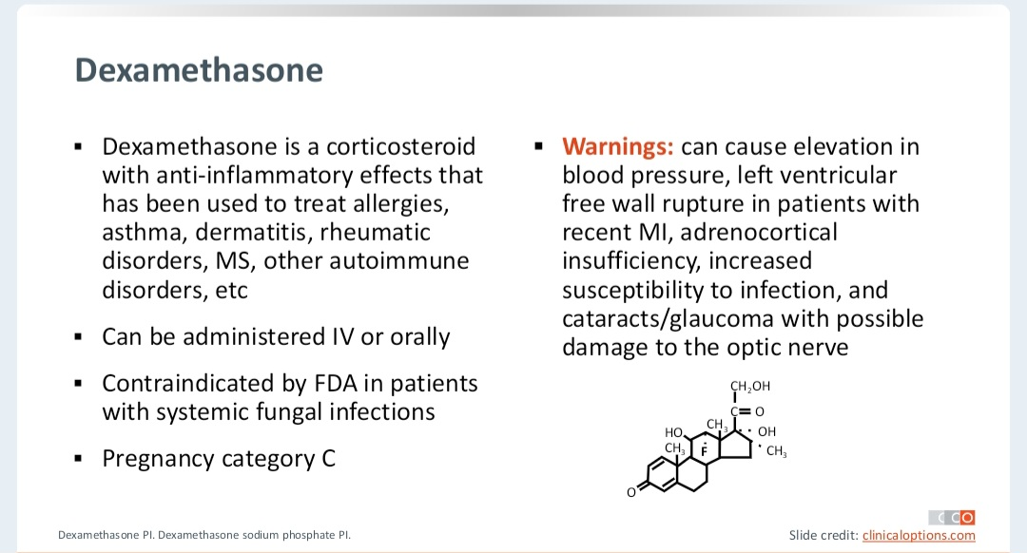

Slide 31
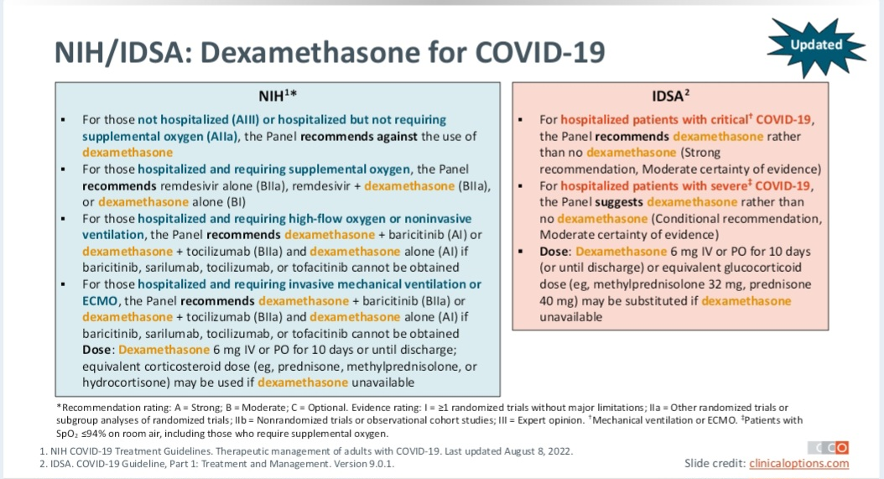

Slide 32
Baricitinib

Slide 33
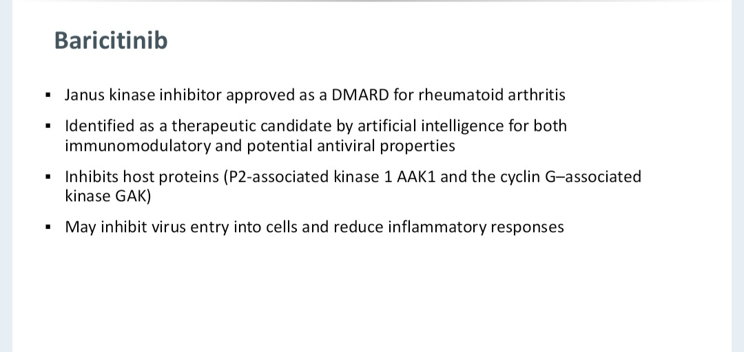

Slide 34
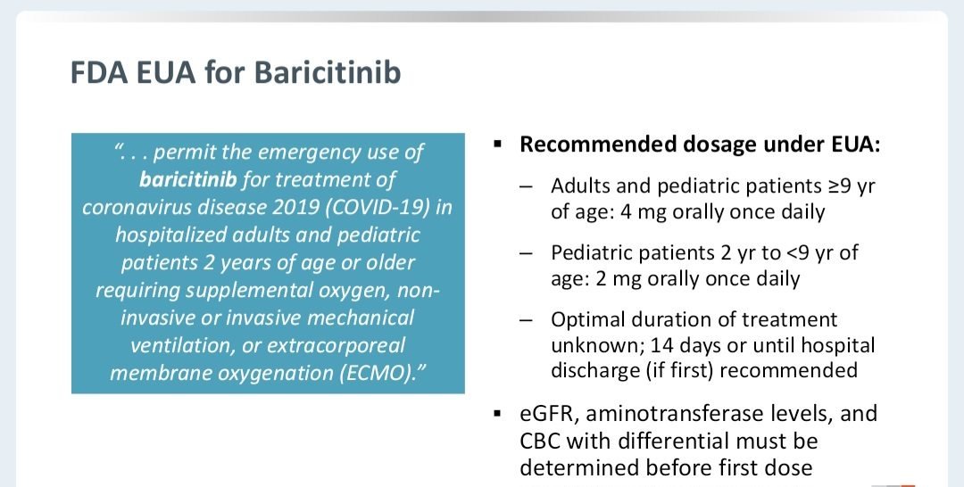

Slide 35
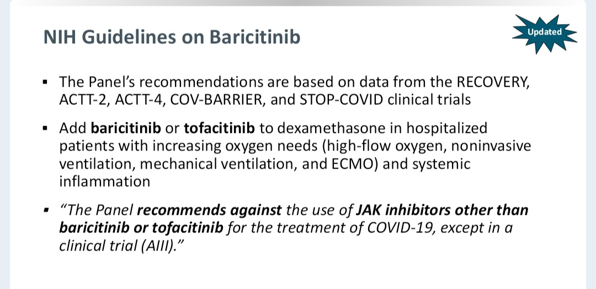

Slide 36
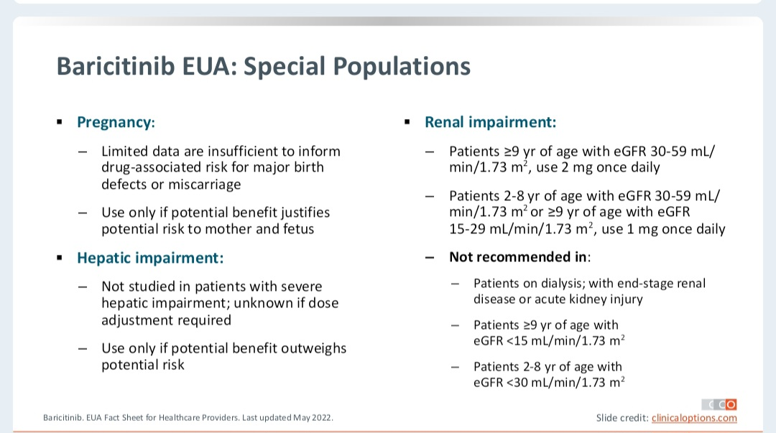

Slide 37
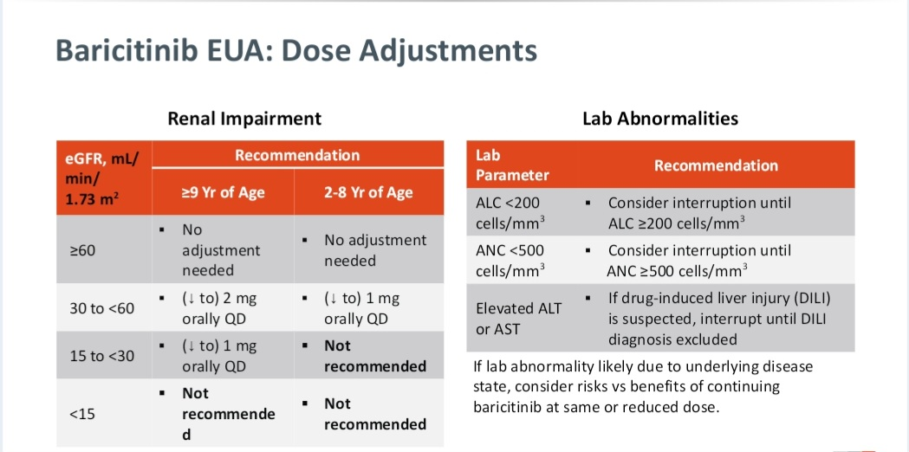

Slide 38
IL-6 inhibitor

Slide 39
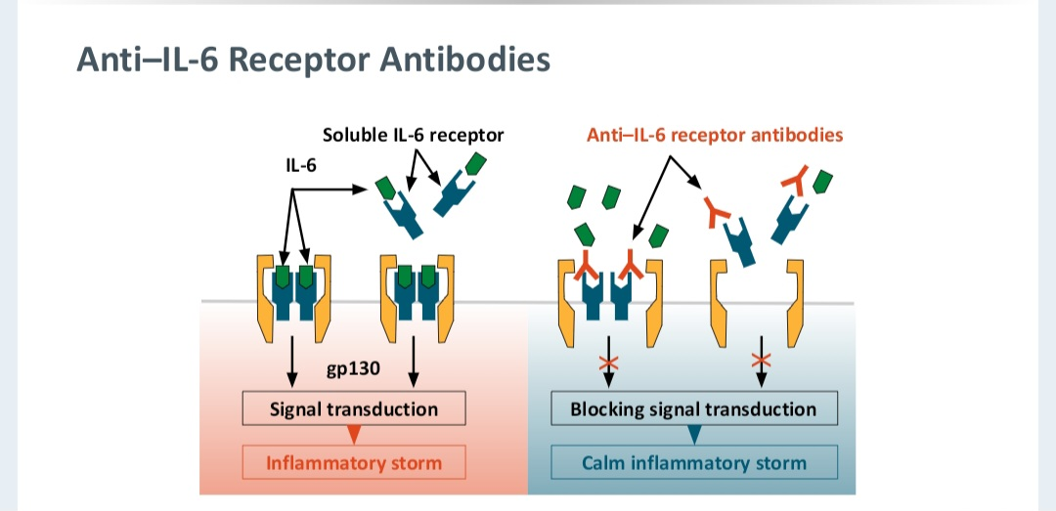

Slide 40
.Interleukin (IL)-6 is a pleiotropic, proinflammatory cytokine produced by a variety of cell types, including lymphocytes, monocytes, and fibroblasts.
.Infection by SARS-CoV induces a dose-dependent production of IL-6 from bronchial epithelial cells.
.COVID-19–associated systemic inflammation and hypoxemic respiratory failure can be associated with heightened cytokine release, as indicated by elevated blood levels of IL-6, C-reactive protein (CRP), D-dimer, and ferritin

Slide 41
.The anti–IL-6 receptor monoclonal antibodies (mAbs) tocilizumab and sarilumab have been evaluated in hospitalized patients with COVID-19 who had systemic inflammation.
.On December 21, 2022, the Food and Drug Administration (FDA) approved the use of intravenous (IV) tocilizumab for the treatment of COVID-19 in hospitalized adults who are receiving systemic corticosteroids and require supplemental oxygen, noninvasive ventilation (NIV), mechanical ventilation, or extracorporeal membrane oxygenation (ECMO)

Slide 42
Tocilizumab and sarilumab should be used with caution in patients with COVID-19 who belong to populations that have not been adequately represented in clinical trials. This includes patients who are significantly immunosuppressed, such as those who have recently received other biologic immunomodulating drugs, and patients with any of the following
• Alanine transaminase levels >5 times the upper limit of normal
• A high risk for gastrointestinal perforation
• An uncontrolled serious bacterial, fungal, or non–SARS-CoV-2 viral infection
• Absolute neutrophil counts <500 cells/μL
• Platelet counts <50,000 cells/μL
• Known hypersensitivity to tocilizumab or sarilumab

Slide 43
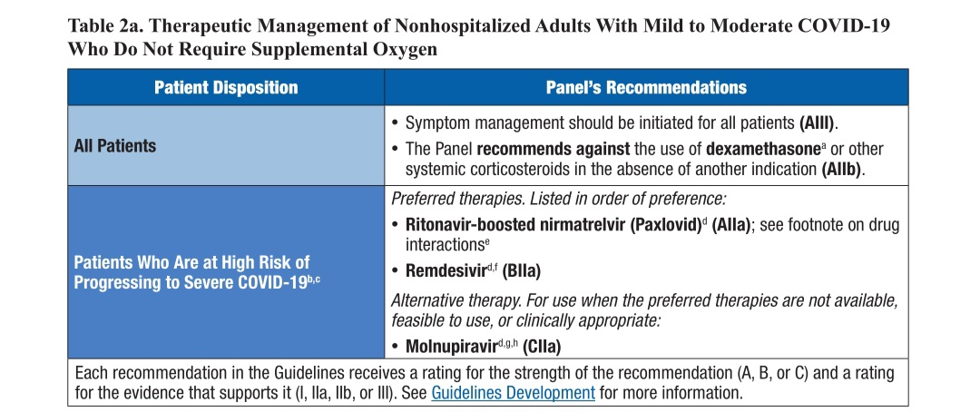

Slide 44
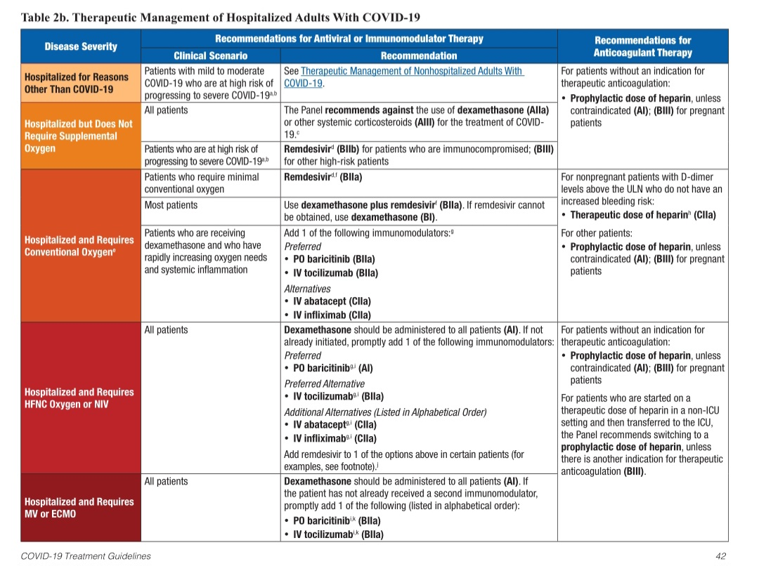

Slide 45
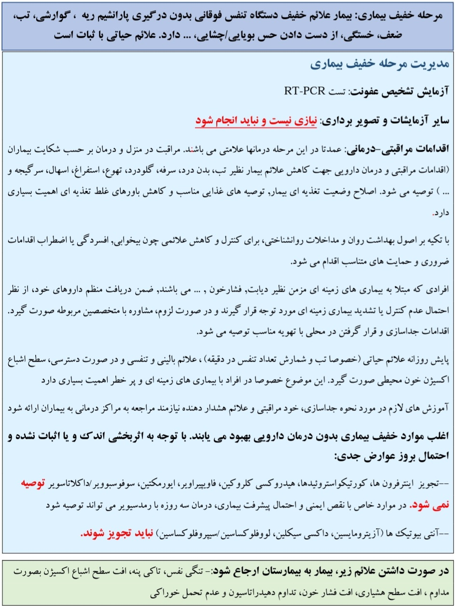

Slide 46
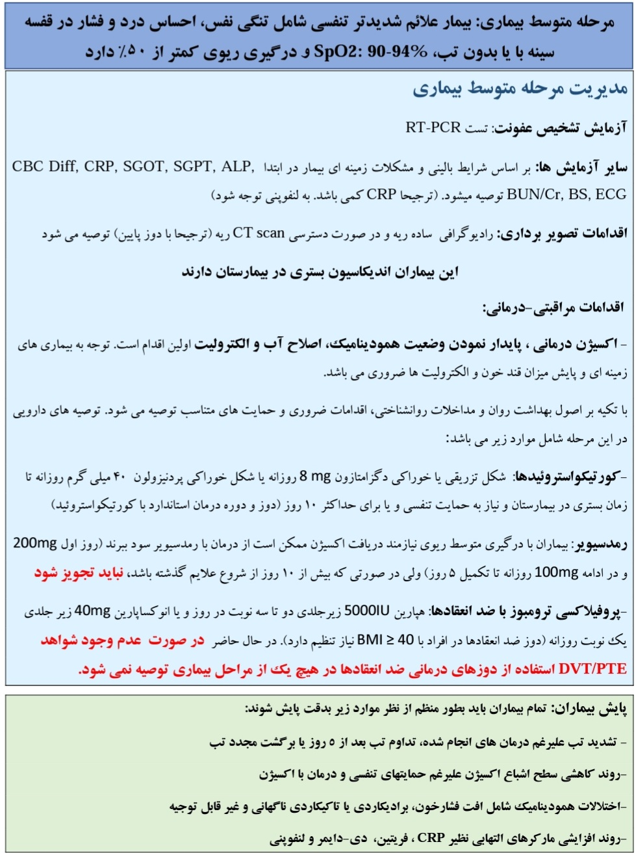

Slide 47
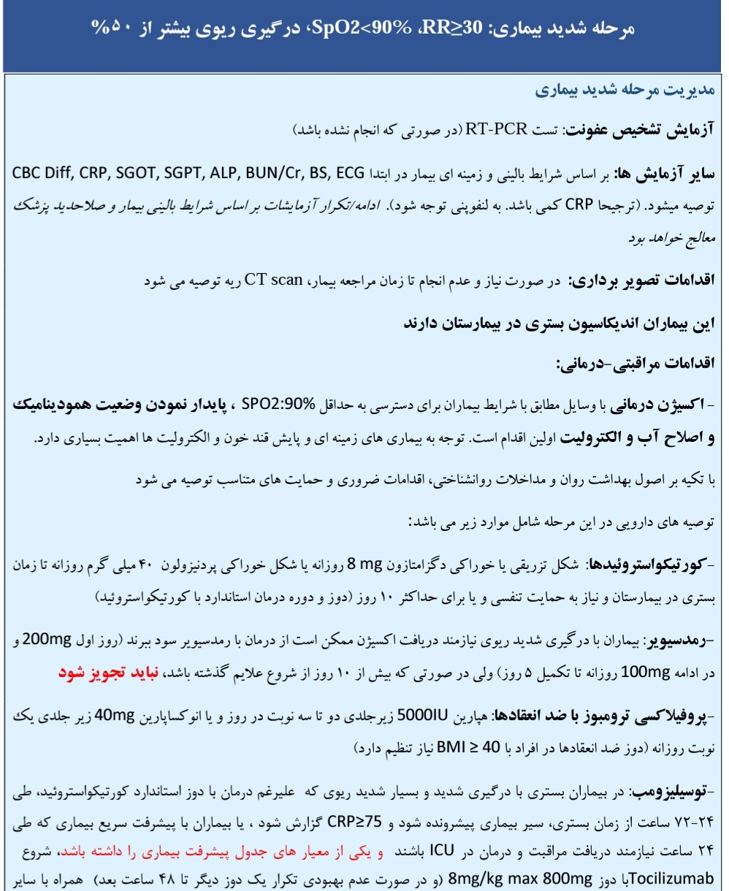

Slide 48
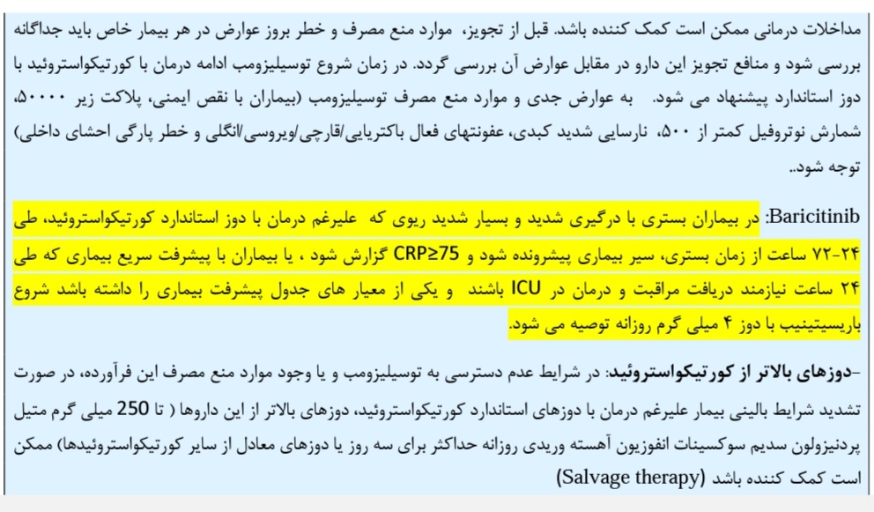

Slide 49
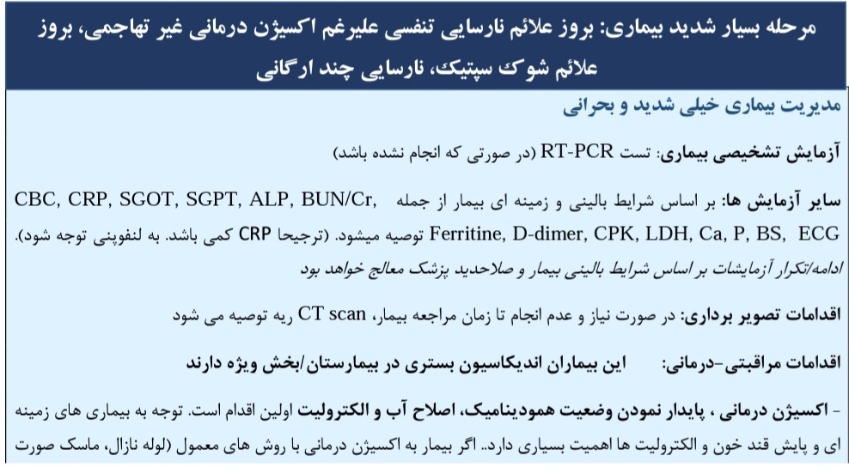

Slide 50
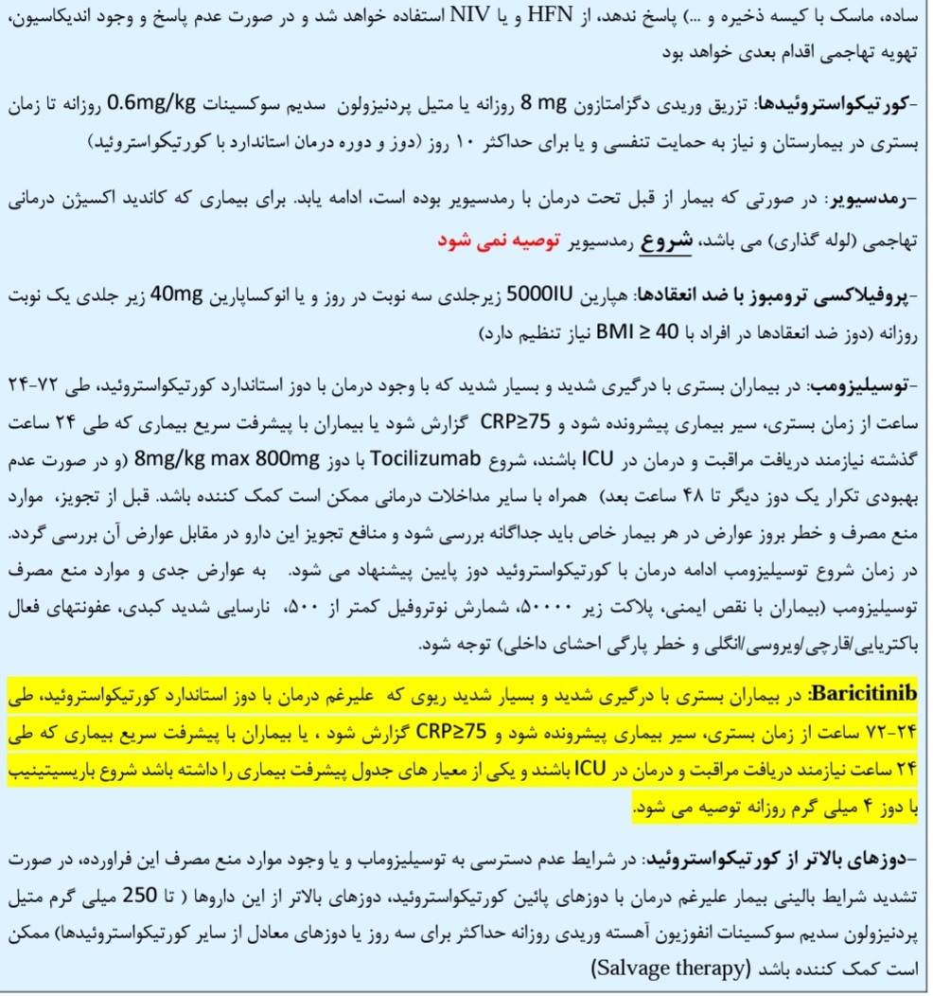

Slide 51
پس از ترخیص بیماران مبتلا به کووید-19 از بیمارستان ادامه مصرف داروهای ضدانعقاد با هدف پروفیلاکسی DVT بطور روتین توصیه نمی شود.
در بیمارانی که بالقوه در معرض خطر بوده و مستعد ابتلا به ترومبوز وریدی باشند ادامه دریافت داروی ضدانعقاد در منزل به مدت 4 هفته توصیه می شود.

Slide 52
در صورتی که جمع نمره های ارزیابی بیمار، مساوی یا بیشتر از 4 باشد بیمار واجد شرایط دریافت داروی ضد انعقاد پس از ترخیص از بیمارستان می تواند باشد.

Slide 53
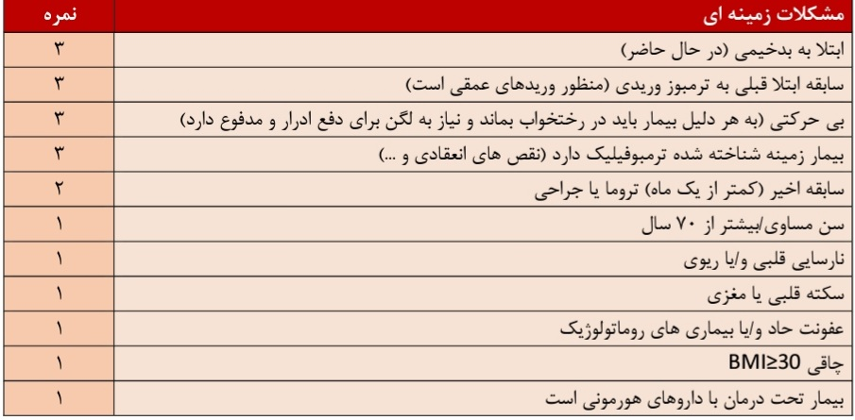

Slide 54

Thank you

