Slide 1
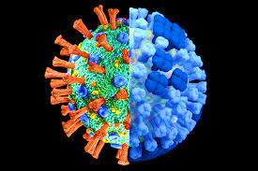
Covid & Flu
Laboratory Diagnosis
Dr. Gouklani
PhD of Virology

Slide 2
objectives
Covid & Flu Laboratory Diagnosis
1
Influensa
Life cycle
2
Coronaviruses
Life Cycle
3
Diagnosis
Flu & SARS Cov II
1

Slide 3
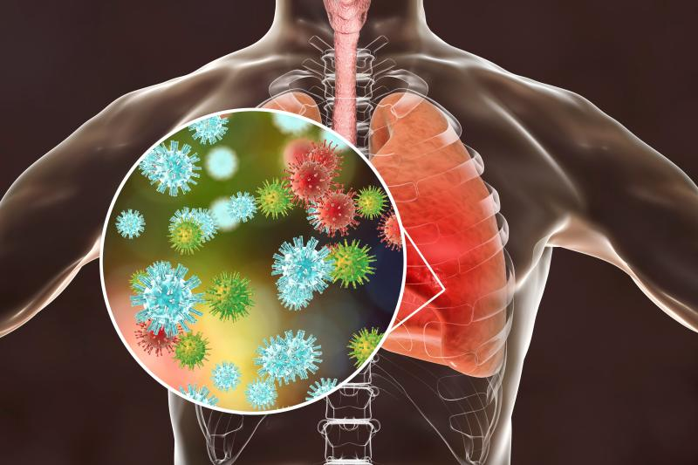
Covid & Flu Laboratory Diagnosis
Acute respiratory illnesses
frequently occurring illness in all age groups - limited to upper airways - self-limiting
small percentage progress to lower respiratory tract infections as bronchiolitis and pneumonia.
Children and elderly people are at increased risk - developing countries.
Flu
Rhino
Adeno
229E, HKU, NL63, OC43
EnV
RSV
Boca
hMPv
SARS I/II
PI 1,2,3
2

Slide 4
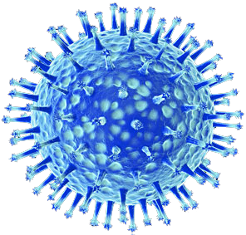
Covid & Flu Laboratory Diagnosis
Family: Orthomyxoviridae
Genus | Species (* indicates type species) | Serotypes or Subtypes | Hosts
Influenzavirus A | Influenza A virus* | H1N1, H1N2, H2N2, H3N1, H3N2, H3N8, H5N1, H5N2, H5N3, H5N8, H5N9, H7N1, H7N2, H7N3, H7N4, H7N7, H9N2, H10N7 | human, pig, horse, seal, whale, bird, chicken, duck
Influenzavirus B | Influenza B virus* |  | Human,
Influenzavirus C | Influenza C virus* |  | Human, pig
Influenza
Seasonal
Pandemic
3

Slide 5
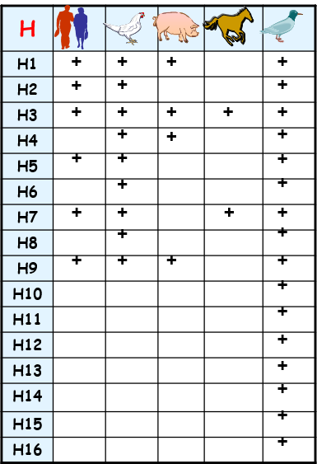
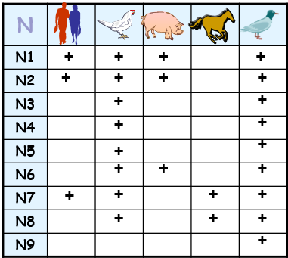
Covid & Flu Laboratory Diagnosis
Influenza
H1N1
H3N2
4

Slide 6
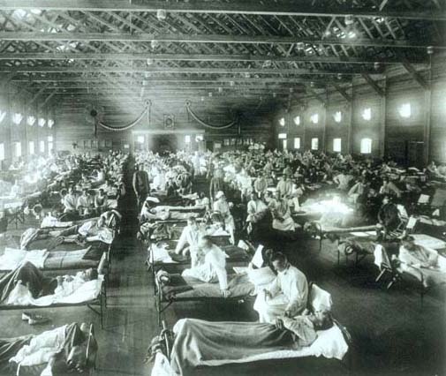
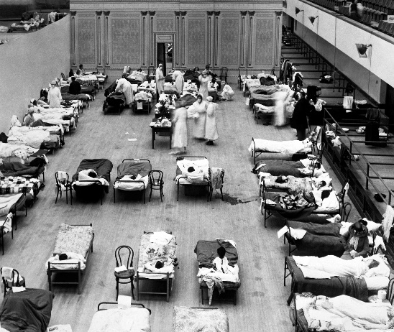
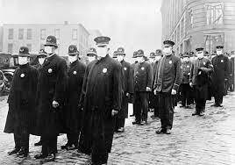
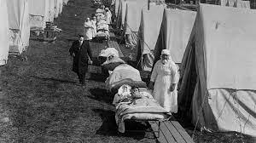
Pandemic Influenza Viruses
Covid & Flu Laboratory Diagnosis
1918: Spanish (H1N1) flu pandemic: affected 20-40 percent of world population-50 million deaths in the world.
1957: Asian (H2N2) flu pandemic: 1 to 1.5 million deaths.
1968: Hong Kong (H3N2) flu pandemic: around 1 million deaths.
2009: Swine Flu (H1N1): 100,000 –400,000 deaths
5

Slide 7
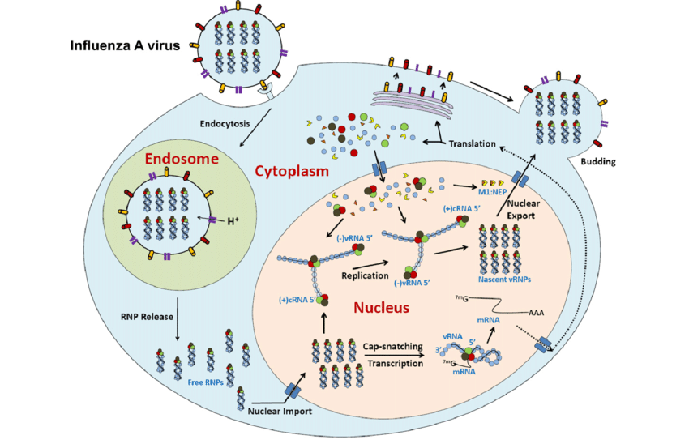
The influenza virus life cycle
Covid & Flu Laboratory Diagnosis
  Amantidine
  Remantidine
  Zanamivir
  Oseltamivir
6
Notes:
Aman

Slide 8
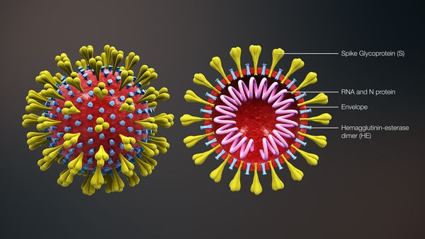
Coronaviruses
Covid & Flu Laboratory Diagnosis
Coronaviruses are a family of viruses known for containing strains that cause potentially deadly diseases in mammals and birds.
In humans they're typically spread via airborne droplets of fluid produced by infected individuals.
7

Slide 9
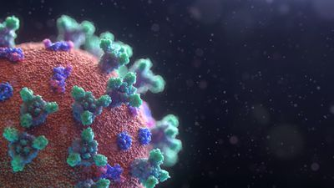
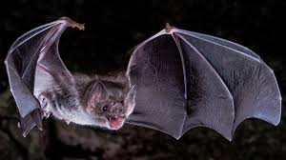
Coronaviruses
Covid & Flu Laboratory Diagnosis
name "coronavirus" derived from Latin corona, meaning "crown“
in the late 1920s coronavirus infection in domesticated chickens
in North America
In the late 1940s, two animal coronaviruses, JHM - MHV
in the 1960s Human coronaviruses 229E and OC43
Other human coronaviruses have since been identified, including SARS-CoV in 2003, HCoV NL63 in 2003, HCoV HKU1 in 2004, MERS-CoV in 2013, and SARS-CoV-2 in 2019.
Globally, as of 6:15pm CET, 8 November 2023, there have been 771,820,937 confirmed cases of COVID-19, including 6,978,175 deaths, reported to WHO.
8

Slide 10
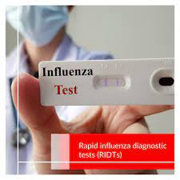
Influenza Diagnostic Tests
Covid & Flu Laboratory Diagnosis
1. Rapid influenza diagnostic tests (RIDTs) :
immunoassays that can identify the presence of influenza A and B viral nucleoprotein antigens in respiratory specimens, and display the result in a qualitative way (positive vs. negative)
Advantages
approximately 15 minutes –
office/bedside use
Disadvantages
false negative results common, sensitivity (50-70%)
Sensitivity to detect flu B viral antigens is lower
cannot distinguish between seasonal influenza A virus infection and novel influenza A virus infection
9

Slide 11
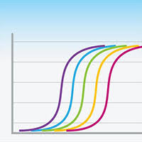
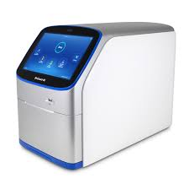
Influenza Diagnostic Tests
Covid & Flu Laboratory Diagnosis
2. Molecular Assays (RT-PCR)
RT-PCR identify the presence of influenza viral RNA or nucleic acids in respiratory specimens with very high sensitivity and specificity.
discriminate between infections with influenza A and B viruses
identify specific seasonal influenza A virus subtypes [A(H1N1)pdm09, or A(H3N2)].
multiplex molecular assays are available that can detect influenza viral nucleic acids and distinguish influenza virus infection from other respiratory
10

Slide 12
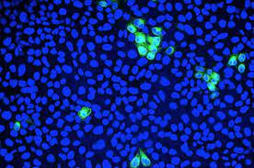
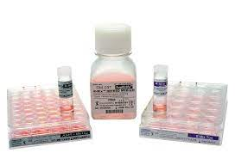
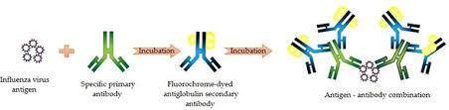
Influenza Diagnostic Tests
Covid & Flu Laboratory Diagnosis
3. Immunofluorescence
antigen detection assays results in 2-4 hours with moderate sensitivity and high specificity
4. Viral Culture
Shell-vial tissue culture results may take 1-3 days, while traditional tissue-cell viral culture results may take 3-10 days
5. Serologic Testing
Serological testing for influenza is not recommended for clinical decision-making.
11

Slide 13
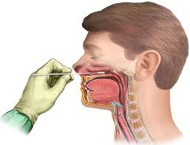
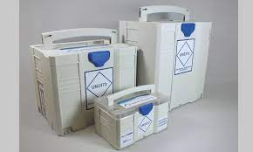
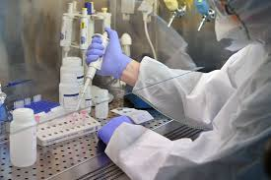
DIAGNOSTIC TESTS FOR COVID‐19
Covid & Flu Laboratory Diagnosis
Molecular Tests (for all variants)
- Sampling ( time of virus shedding/between 2, 3 to 20 days after exposure)
false negative: improper collection, insufficient amount of virus,
NO standard NP and OP swabs
- Transport at 4^{oc}
- Genome Extraction false positive & negative: cross contamination /
inhibition
- PCR false positive & negative
12

Slide 14
DIAGNOSTIC TESTS FOR COVID‐19
Covid & Flu Laboratory Diagnosis
2. Serological assays (Based on antibodies antigenic protein)
Both past and current SARS‐CoV‐2 infections can be detected
cheaper and take less time to diagnose, and less complicated
disadvantages:
cannot be used in the early stages of the infection (up to the sixth day)
do not provide information about the viral load
the reliability rate of serological kits is limited (89%–99%) due to false‐positive results in patients infected with other human coronavirus types such as HCoV‐OC43 and HCoV‐229E because of cross‐reactivity and false‐negative results in immunocompromised individuals
They are not preferred as the primary test in hospitals but allow individuals to test themselves based on the presence–absence of the virus at home.
13

Slide 15
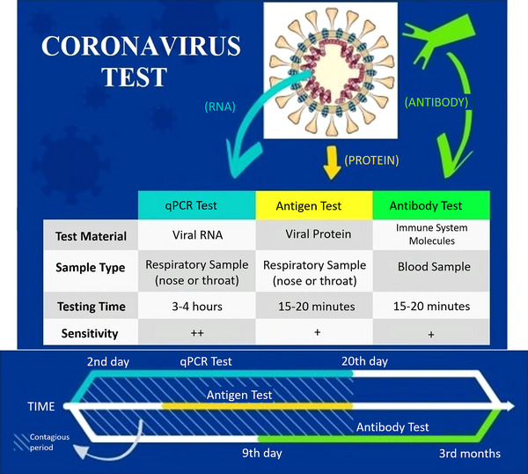
DIAGNOSTIC TESTS FOR COVID‐19
Covid & Flu Laboratory Diagnosis
14

Slide 16
multiplex molecular assays
detected co-infection
Respiratory Flow Chip Kit: 21 pathogens
Flu A,B, H1N1,H3, h. MPv, RSV, Rhino, Enter/P.I 1,2,3,4, Aden, Boca, 229E, HKU, NL63, OC43, SARS-CoV-2
15

Slide 17
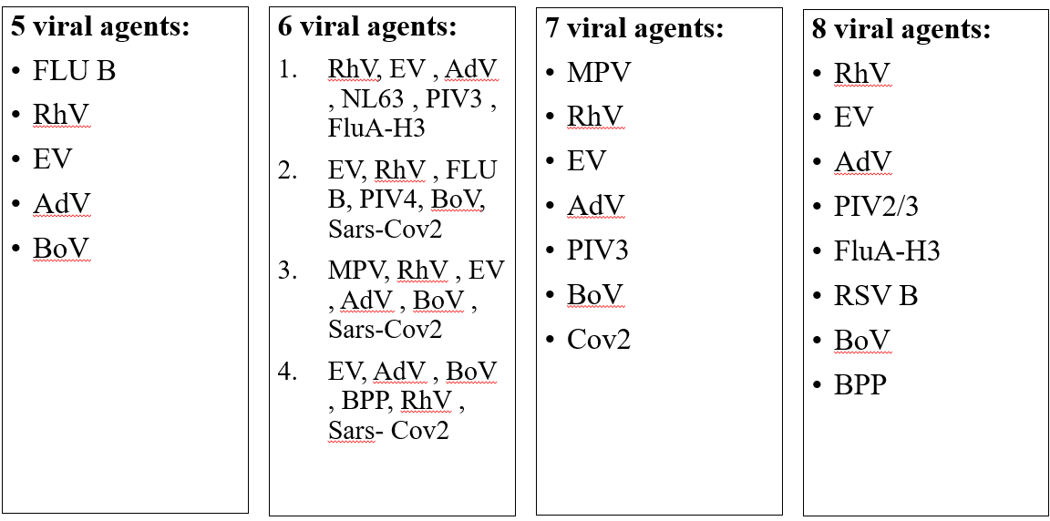
Respiratory Flow Chip Kit: 21 pathogens
Flu A,B, H1N1,H3, h. MPv, RSV, Rhino, Enter/P.I 1,2,3,4, Aden, Boca, 229E, HKU, NL63, OC43, SARS-CoV-2
16

Slide 18
Thank You

