Slide 1
Treatment of HIV Infection

Slide 2
درمان ضد رتروويروسی يک درمان مادام العمر است که باعث کاهش مرگ و میر و ناتوانی در مبتلايان در مراحل مختلف بالینی شده و نیز میزان انتقال ويروس را به ديگران بشدت کاهش می دهدa

Slide 3
کاهش التهاب
و فعال شدن سیستم ايمنی
در نتیجه میزان عوارض قلبی-عروقی و آسیب به اعضاء مختلف کاهش می يابد
قطع درمان با برگشت بار ويروسی خون، تضعیف سیستم ايمنی بروز مقاومت دارويی، افزايش ناتوانی و مرگ و میر همراه است.

Slide 4
Combination antiretroviral therapy (ART) improves clinical outcomes across the entire spectrum of HIV disease, including:
those with a prior AIDS-defining illness
asymptomatic individuals with moderate
immunosuppression (CD4 200–350)
even in those with normal CD4 cell counts

Slide 5
In addition,
suppressive ART virtually eliminates the risk of HIV transmission

Slide 6
زمان شروع درمان ضد رتروویروسی:
درمان ضدرتروويروسی بايد در همه مبتلايان بدون توجه به:
مرحله بیماری
CD4ومیزان

Slide 7
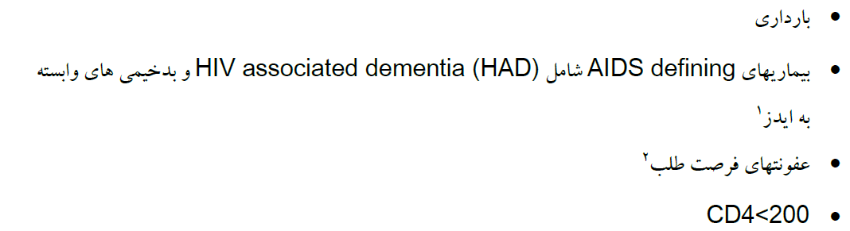
شروع درمان در موارد زير با سرعت بیشتري توصیه می شود

Slide 8
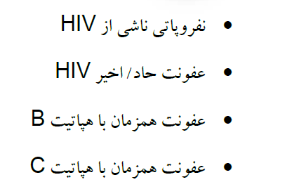
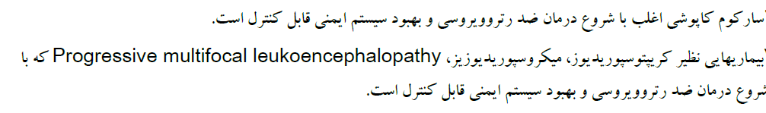
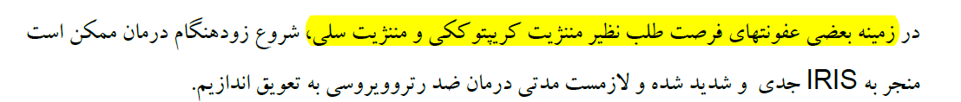

Slide 9
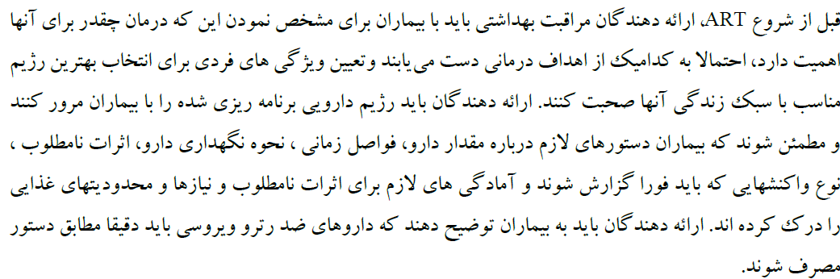
ARTآموزش بیمار قبل از شروع

Slide 10
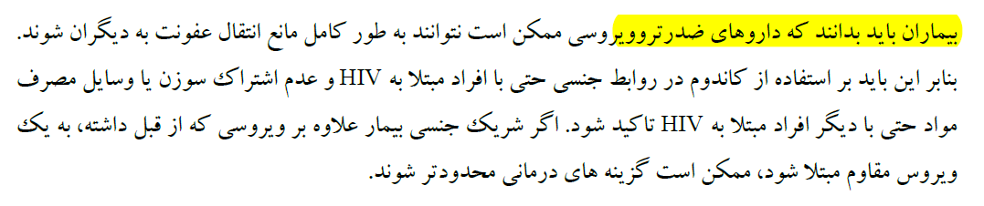
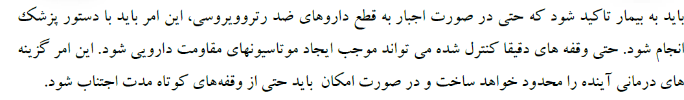

Slide 11

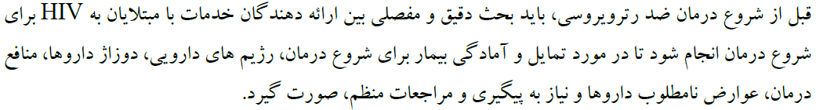
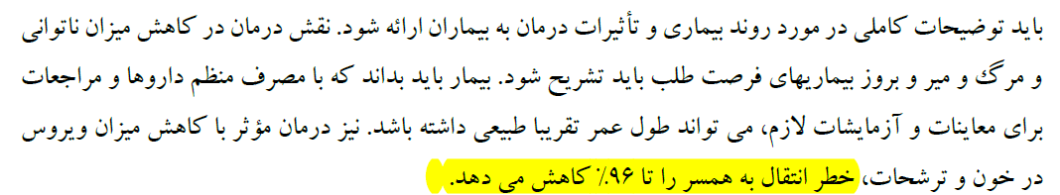

Slide 12
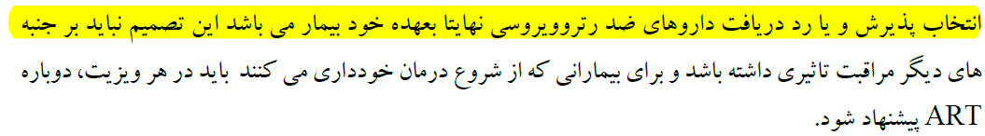

Slide 13
The primary goals of therapy are
prolonged suppression of viral replication to undetectable levels (HIV RNA < 20–40 copies/mL depending on assay), restoration/preservation of immune function, and improved clinical outcome

Slide 14

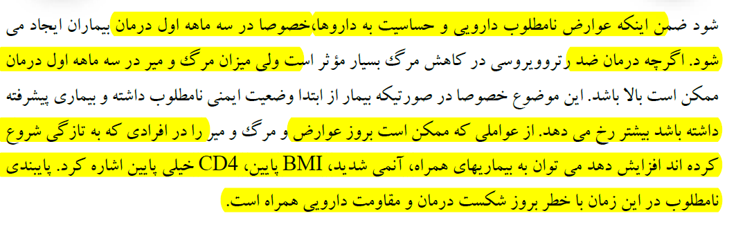

Slide 15
Antiretroviral Agents Used
for HIV Infection

Slide 16
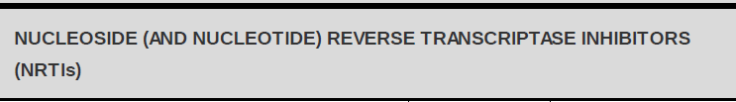




Slide 17



Slide 18



Slide 19



Slide 20

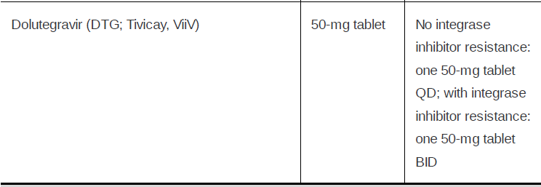

Slide 21
RAL
has the fewest drug interactions, but must be take twice daily and is not available as coformulated full regimen
EVG/c
Is coformulated with the optimal NRTI pair (TAF/FTC), but has the most drug interactions due to the requirement for cobicistat for once-daily dosing.
DTG
is once daily and has the highest resistance barrier, but is only coformulated with ABC/3TC

Slide 22
for patients not requiring a single tablet for treatment, the two-pill regimen of TAF/FTC
plus DTG provides the best combination of efficacy and safety
For those wanting a single pill option, and who do not have significant drug interactions, TAF/FTC/EVG/c is preferred

Slide 23
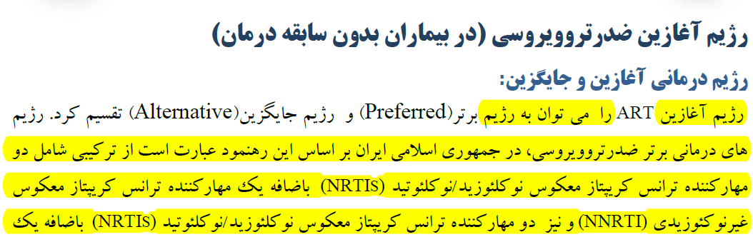


Slide 24
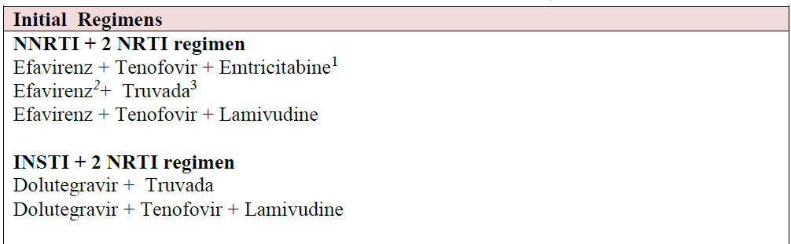

Slide 25
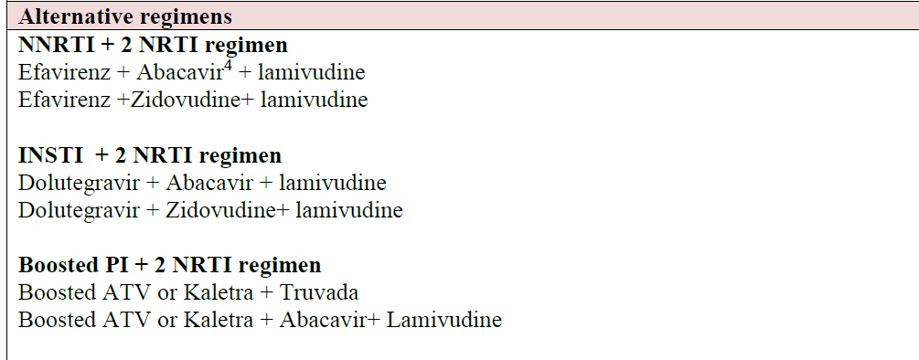

Slide 26
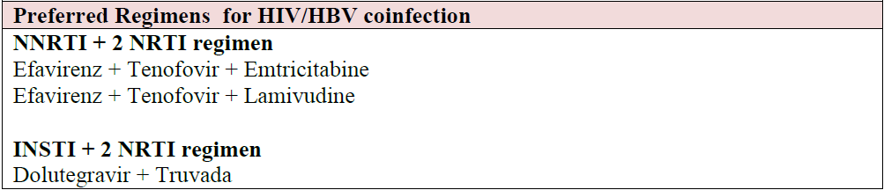
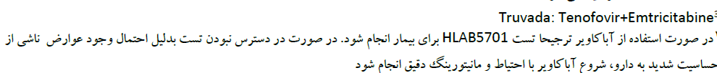

Slide 27
Recommended Regimen Options
Recommended regimens are those with demonstrated durable virologic efficacy,favorable tolerability and toxicity profiles, and ease of use
INSTI plus Two-NRTI Regimen:
DTG/ABC/3TC (AI)—if HLA-B*5701 negative
DTG plus either TDF/FTC (AI) or TAF/FTC (AII)
EVG/c/TAF/FTC (AI) or EVG/c/TDF/FTC (AI)
RAL plus either TDF/FTC (AI) or TAF/FTC (AII)
Boosted PI plus Two NRTIs:
DRV/r plus either TDF/FTC (AI) or TAF/FTC (AII)

Slide 28
Alternative Regimen Options Alternative regimens are effective and tolerable, buthave potential disadvantages when compared with the recommended regimens,
However, an alternative regimen may be the preferred regimen for some patients

Slide 29
NNRTI plus Two NRTIs:
EFV/TDF/FTC (BI)
EFV plus TAF/FTC (BII)
RPV/TDF/FTC (BI) or RPV/TAF/FTC (BII)—if HIV RNA < 100,000 copies/mL
and CD4 > 200 cells/mm
Boosted PI plus Two NRTIs:
(ATV/c orATV/r) plus either TDF/FTC (BI) or TAF/FTC (BII)
DRV/c (BIII) or DRV/r (BII) plus ABC/3TC —if HLA-B*5701 negative
DRV/c plus either TDF/FTC (BII) or TAF/FTC (BII)

Slide 30
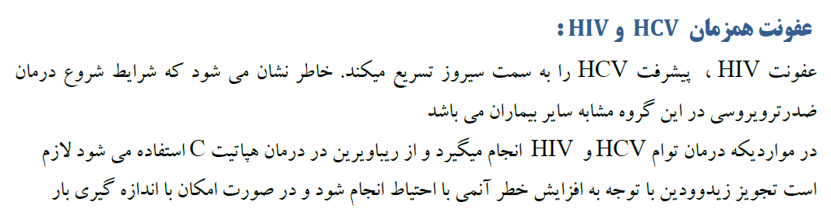
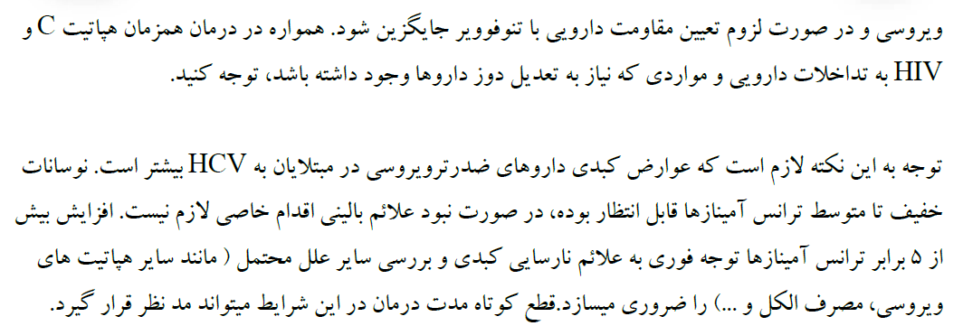

Slide 31
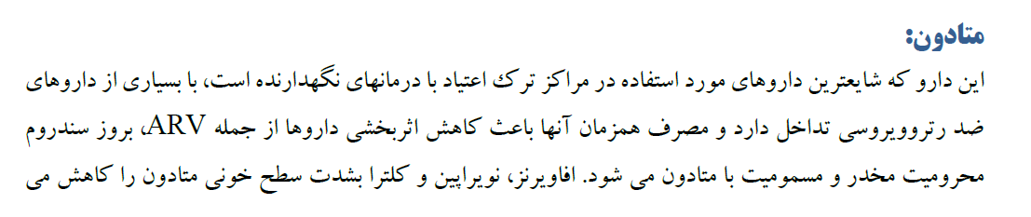
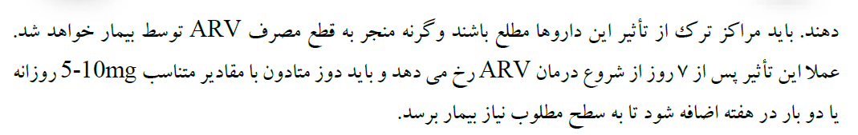

Slide 32
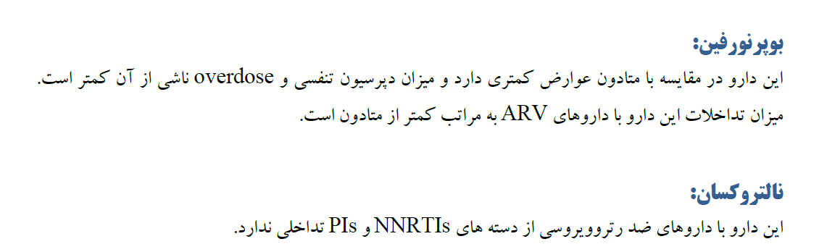

Slide 33
