Slide 1
Staging and clinical presentation of HIV infection

Slide 2
.
Human immunodeficiency virus (HIV) infection results in a wide range
of clinical consequences from asymptomatic infection despite active
viral replication to severe immunodeficiency with life-threatening
opportunistic disease.

Slide 3
HIV infection causes disease manifestations of three principal types:
(1) an acute viral illness seen in the initial weeks of infection and
associated with a high viral load and an intense host immune response
(2) immunologically mediated processes related to host responses to chronic viral infection in the absence of ART (e.g.,lymphadenopathy,
thrombocytopenia, HIV-related dementia) or persistent inflammation
even following ART initiation (e.g., cardiovascular disease, dyslipidemia,
hypercoagulability, other metabolic disorders);
(3) Opportunistic diseases resulting from impaired host responses as the cellular immune system is damaged or ablated. The major clinical syndromes most frequently seen in HIV-infected individuals fall into the
last category

Slide 4
Potent ART has added two new categories of clinical manifestations that may be commonly encountered in patients with HIV infection:
(1) immune reconstitution syndromes with exacerbations of previously
silent or adequately treated infections, especially mycobacterial infections,
(2) a syndrome of lipodystrophy with fat loss and redistribution, elevated serum triglyceride and cholesterol levels and insulin resistance seen in
, patients receiving ART, especially with protease inhibitors

Slide 5
Acute Retroviral Syndrome
The initial manifestation of HIV infection in one-half to three-quarters of recently infected individuals is a mononucleosis-like illness referred to as acute retroviral syndrome.
The clinical features of acute retroviral syndrome are nonspecific and variable
The onset of the illness ranges from 1 to 6 weeks after exposure to the virus
but peaks at 3 weeks

Slide 6
Fever, sweats, malaise, myalgias, anorexia, nausea, diarrhea, and a
nonexudative pharyngitis are prominent symptoms
Many patients report headaches, photophobia, and meningismus.
Two-thirds of patients may have a truncal exanthem that may be
maculopapular, roseola-like, or urticarial
In addition to aseptic meningitis, neurologic symptoms occur
in a minority of patients and may include encephalitis, peripheral neuropathy, and an acute ascending polyneuropathy (Guillain-Barré syndrome).

Slide 7
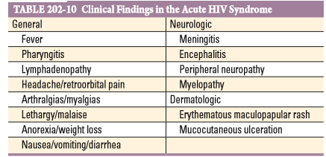

Slide 8
Persistent Generalized
Lymphadenopathy
The syndrome of PGL is defined as the presence of two or more
extrainguinal sites of lymphadenopathy for a minimum of 3 to 6 months
for which no other explanation can be found
Biopsy specimens of lymph nodes from such patients usually reveal a follicular
Hyperplasia without specific pathogens
PGL develops in 50% to 70% of HIV-infected individuals.

Slide 9
The most frequently involved node groups are the posterior
and anterior cervical, submandibular, occipital, and axillary chains;
epitrochlear and femoral nodes may also be enlarged
Physical examination usually reveals symmetrical, mobile, rubbery lymph nodes ranging from 0.5 to 2 cm.

Slide 10
Constitutional Disease and Wasting
HIV infection is often completely asymptomatic; however, some patients
present with nonspecific constitutional symptoms in the months or
years after primary infection but before opportunistic disease is diagnosed.
Patients commonly report being easily fatigued and the need to reduce
their normal activities.
Debilitating fatigue is uncommon in the early years of infection
Low-grade fevers (temperature <38°C [100.4°F]),
occasional night sweats, and intermittent diarrhea are also reported.

Slide 11
Severe wasting, with loss of more than 10% of body weight, is generally
a finding of advanced HIV disease. The exact incidence of constitutional
symptoms, fatigue, and weight loss is not known, and the cause is varied and often multifactorial
The differential diagnosis of these findings includes intercurrent minor illnesses, endocrinologic abnormalities, anemia, and psychological or psychiatric disorders.

Slide 12
METABOLIC AND ENDOCRINE
ABNORMALITIES
• Hypogonadism, adrenal insufficiency, constitutional wasting, lipid abnormalities,
insulin resistance, lipodystrophy, and osteoporosis have been reported

Slide 13
ORAL DISEASE
• Oral candidiasis, oral hairy leukoplakia, gingivitis, and periodontitis may occur

Slide 14
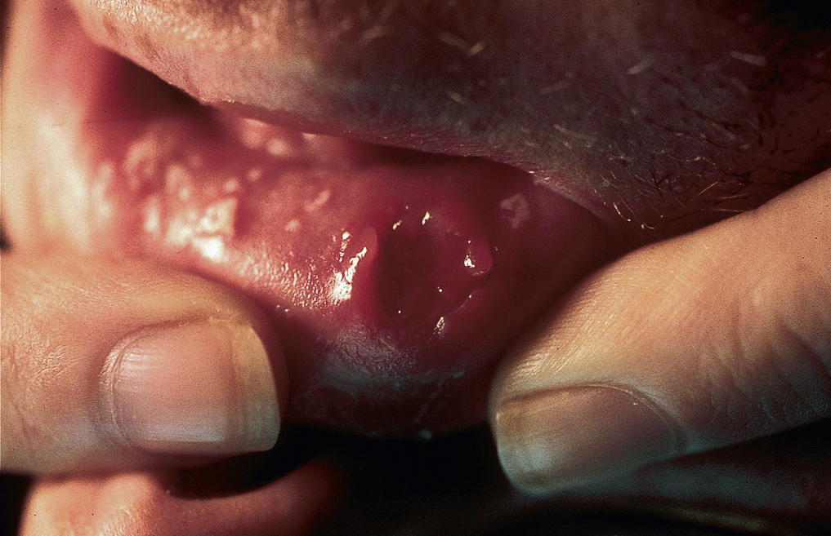
Aphthous ulcer.

Slide 15
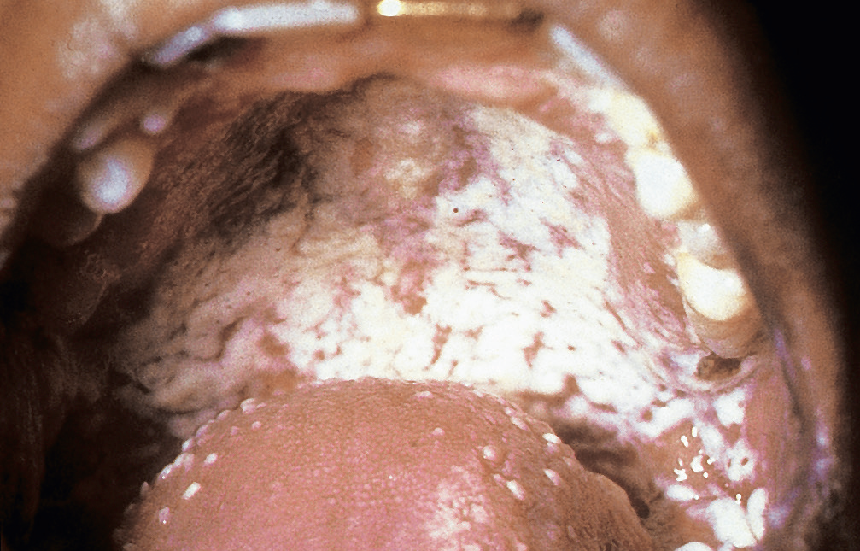
Oral candidiasis (thrush(

Slide 16
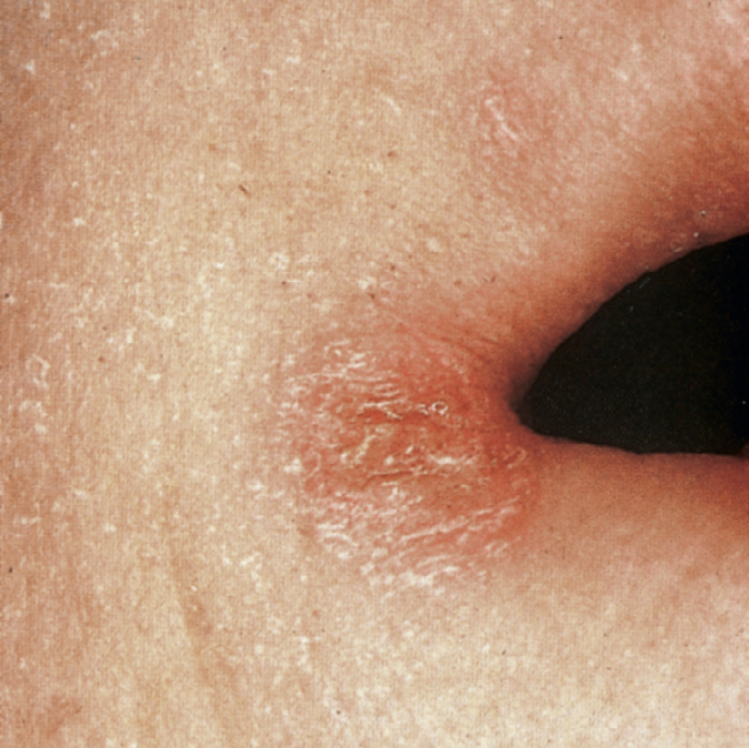
Angular cheilitis

Slide 17
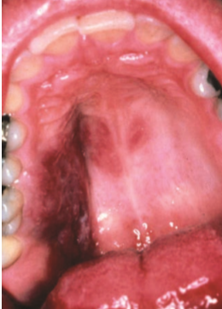
Kaposi’s sarcoma

Slide 18
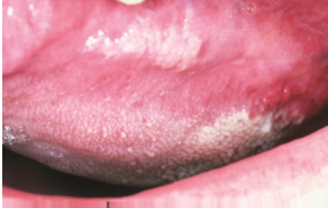
Hairy leukoplakia

Slide 19
CUTANEOUS DISEASE
• Dermatologic consequences include cutaneous
infections (herpes simplex virus, varicella-zoster virus
, molluscum contagiosum, scabies, bacillary angiomatosis
, and Kaposi sarcoma).

Slide 20
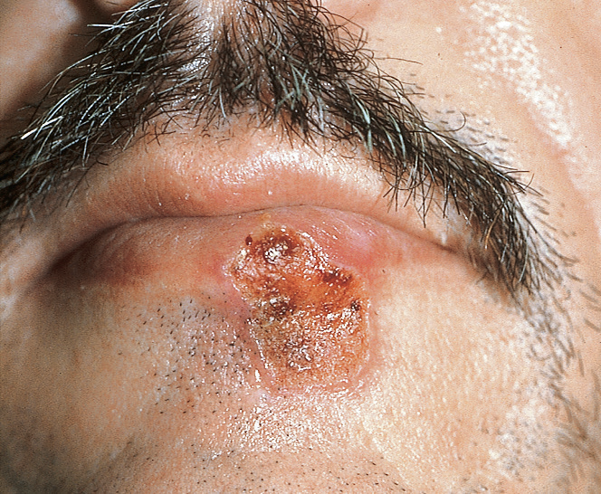
Herpes simplex cheilitis

Slide 21
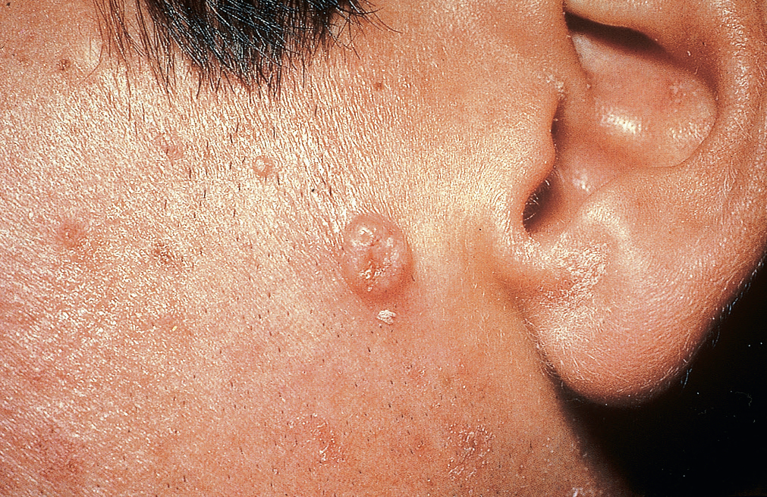
Molluscum contagiosum.

Slide 22
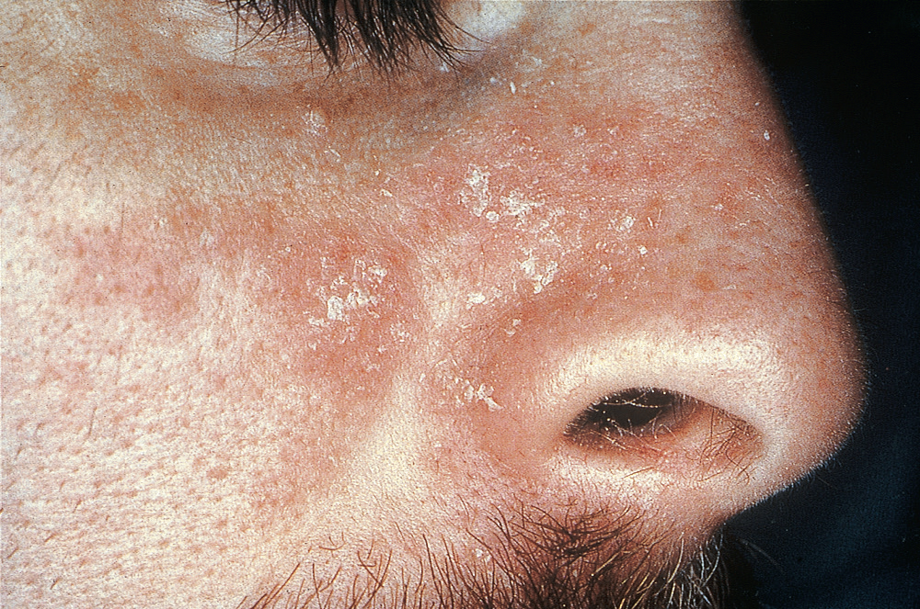
Seborrheic dermatitis.

Slide 23
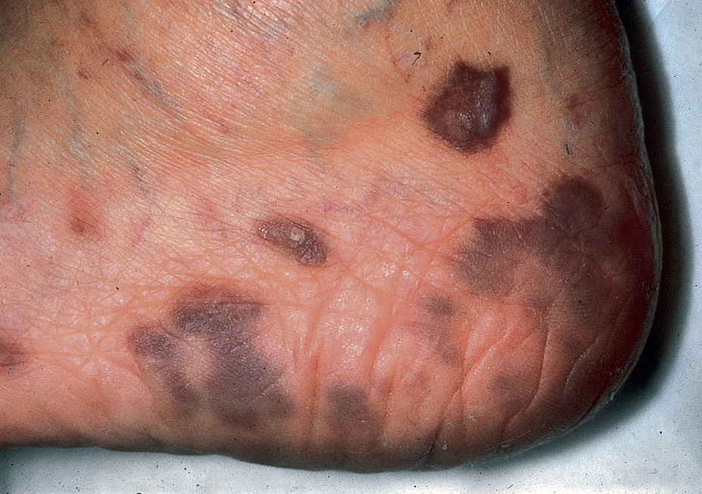
Kaposi sarcoma.

Slide 24
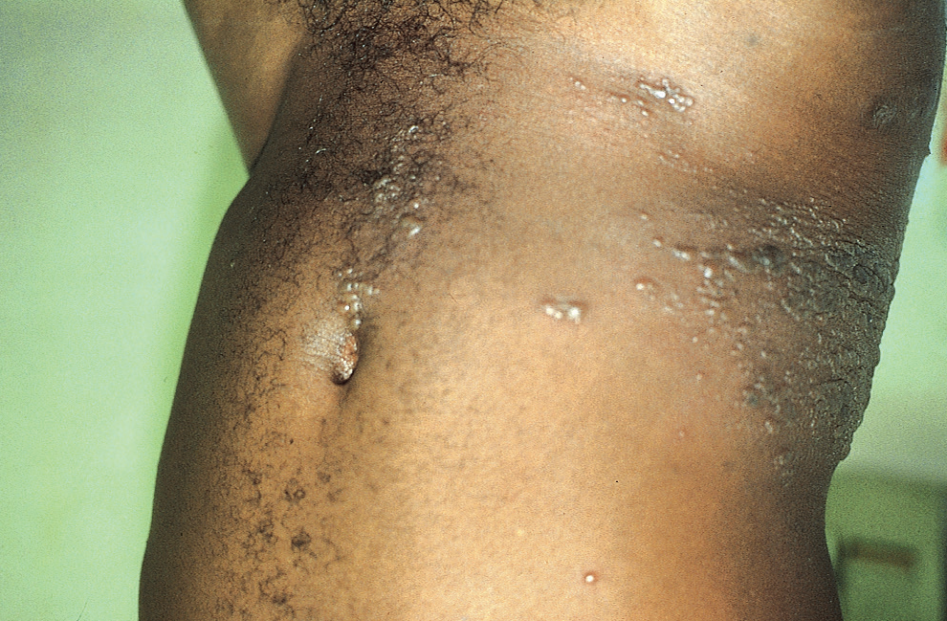
Herpes zoster in dermatomal distribution.

Slide 25
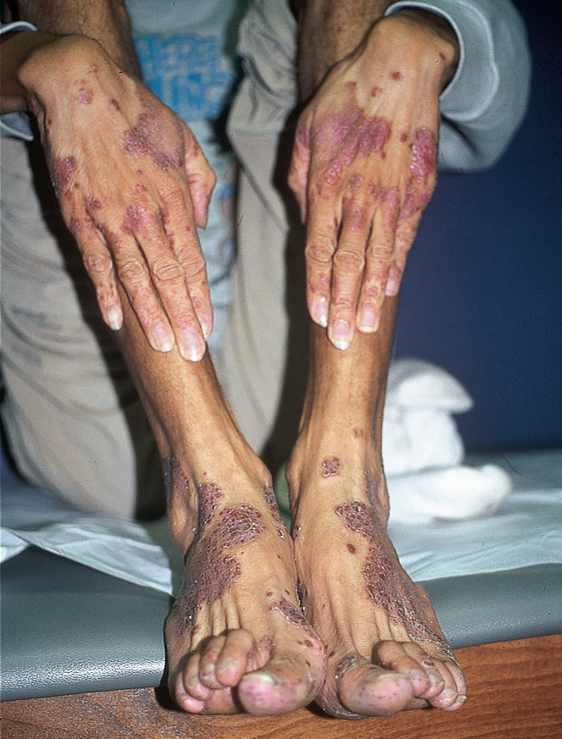
Norwegian scabies (in a patient with wasting syndrome).

Slide 26
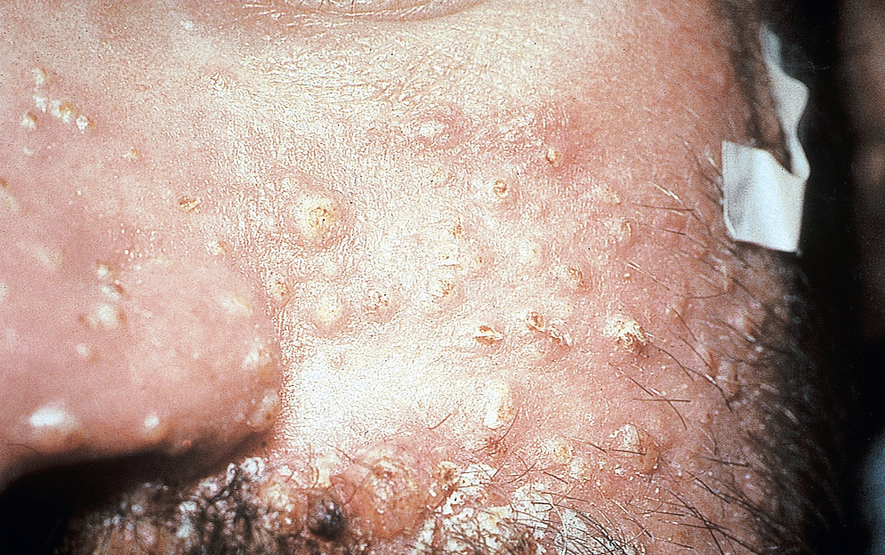
Cryptococcosis.

Slide 27
RENAL DISEASE
• Multiple causes of renal disease may affect patients with HIV infection as well as a specific HIV-related nephropathy, which
includes proteinuria, mildly elevated serum creatinine concentration reflecting glomerular injury, mesangial proliferation, and tubular degeneration.

Slide 28
CARDIAC DISEASE
• Accelerated atherosclerosis with myocardial infarction is seen in patients with HIV infection who have been treated with ART and appears to be associated with elevations in proinflammatory cytokines and prothrombotic markers
• Myocarditis and pericarditis are also found.

Slide 29
Ocular DISEASE
Ocular diseases are extremely common manifestations of HIV disease with a wide variety of causes ranging
from a benign HIV retinopathy to sight-threatening
viral opportunistic infections.
CMV retinitis
Varicella-zoster retinitis
Ocular toxoplasmosis
P. jirovecii
choroiditis

Slide 30
IMMUNE RECONSTITUTION SYNDROMES
• Immune reconstitution syndromes are seen after ART and can involve Mycobacterium tuberculosis, Mycobacterium avium complex, Cryptococcus neoformans, cytomegalovirus, hepatitis B, hepatitis C, lymphoma, and other opportunistic diseases

Slide 31
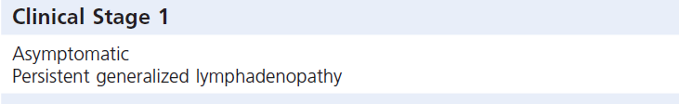
World Health Organization Clinical
Staging of HIV/AIDS for Adults and Adolescents
With Confirmed HIV Infection

Slide 32
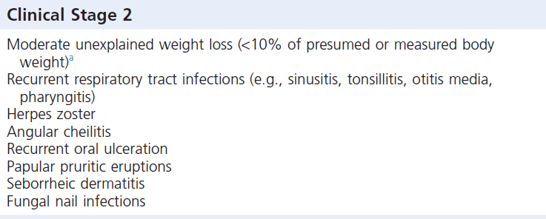

Slide 33
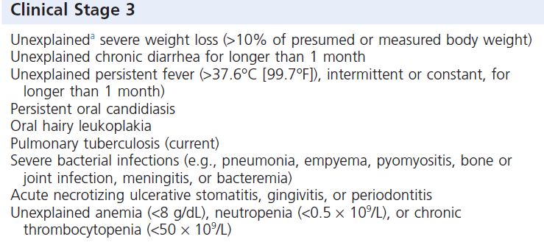

Slide 34
